Slide 1


^{when the sun rises}
^{we work hard to deliver}
PPTICRM CALLIBRATION WORKSHOP
Turning ICRM Component 1: Administration to Green
Nkangala District Experience
14 – 17 September 2015

Slide 2



STRUCTURE OF PRESENTATION
Background
Turning component 1: Administration from Red to Green?
Understanding the scope of work to be done
Where did we begin
Getting Organised
DEPARTMENT OF HEALTH
MPUMALANGA PROVINCE
REPUBLIC OF SOUTH AFRICA

Slide 3
BACKGROUND
Nkangala District is one of the three health districts in Mpumalanga Province
It has the 2nd largest population in the province at 1 407 467
with 89 PHC facilities
The plan is to have 27 PHC facilities achieve ideal status by March 2015/16
DEPARTMENT OF HEALTH
MPUMALANGA PROVINCE
REPUBLIC OF SOUTH AFRICA

Slide 4
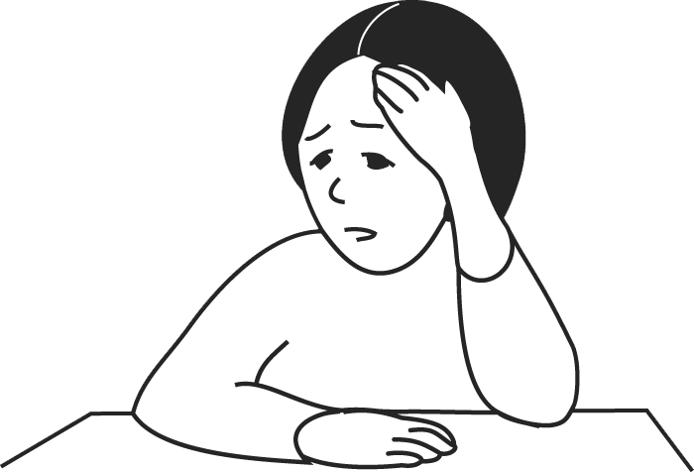
Is it Possible to turn Component 1: Administration to GREEN?
23 /212 Elements?
Road signs ?
Display boards ?
Appropriate access for people with disabilities?
DEPARTMENT OF HEALTH
MPUMALANGA PROVINCE
REPUBLIC OF SOUTH AFRICA

Slide 5

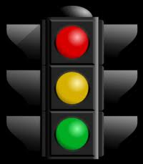
ICRM Component: 1 Administration – Red – Green ?
How then do we
turn
Administration
elements to Green
DEPARTMENT OF HEALTH
MPUMALANGA PROVINCE
REPUBLIC OF SOUTH AFRICA

Slide 6
Understanding the Scope: Component :1 Administration
Sub Component | Elements | Vital | Essential | Important | Control
 |  |  |  |  | H. F | DISTR. | PDOH | NDOH
1.Signage & Notices | 8 | 0 | 0 | 8 | 2 | 5 | 1 | 0
2. Staff identity & dress codes | 2 | 0 | 0 | 2 | 1 | 0 | 1 | 0
3. Client service organisation | 4 | 2 | 0 | 2 | 3 | 1 | 0 | 0
4. Management of client records | 9 | 0 | 1 | 8 | 8 | 0 | 0 | 1
TOTAL | 23 | 2 | 1 | 20 | 14 | 6 | 2 | 1
Vital = 100% Essential = 75% Important = 60%
Link - NCS 1&6
DEPARTMENT OF HEALTH
MPUMALANGA PROVINCE
REPUBLIC OF SOUTH AFRICA

Slide 7
Where to begin? Started with things that can be fixed
Quick wins / Small wins: - Area of Influence
A functional wheelchair and stretcher are always available (Vital)
Client record content adheres to ICSM prescripts (Essential)
The organogram with contact details of the managers displayed (Important)
All service areas including reception and toilets within the facility clearly sign posted (Important)
All staff members comply with prescribed dress code (Important)
Overarching interventions
Use the ideal clinic Manual version 16 as a guide - PROCESS
DEPARTMENT OF HEALTH
MPUMALANGA PROVINCE
REPUBLIC OF SOUTH AFRICA

Slide 8
Breakthrough Interventions: Administration
Prioritised elements in terms of weighting ( Vitals & Essential):
Vitals x2
There is appropriate access for people with disabilities (District)
A functional wheelchair and stretcher are always available (Health Facility)
Essentials x1
Client record content adheres to ICSM prescripts (Health Facility)
DEPARTMENT OF HEALTH
MPUMALANGA PROVINCE
REPUBLIC OF SOUTH AFRICA

Slide 9
Outlining and Costing elements requiring District Intervention
There is appropriate access for people with disabilities (Vital)
Display board reflecting the facility name, service hours physical address, postal, telephone, facsimile or electronic mail and service package details at the entrance of the facility, disclaimer on searches(Important)
Photos of political leadership of health are visually displayed (Important)
The Mission, Vision, Belief, Goals of the health facility are displayed for patients to clearly see (Important)
DEPARTMENT OF HEALTH
MPUMALANGA PROVINCE
REPUBLIC OF SOUTH AFRICA

Slide 10
Clustering & costing elements requiring District Intervention
ICRM COMPONENTS REQUIRING DISTRICT INTERVENTION
Components | Ideal Clinic Dashboard Reference | Weighting | Responsibility | Time Frame | No of Facilities | Costs
Administration | The GUN FREE, NO SMOKING, NO ANIMALS (except for service animals) and NO HAWKERS sign is clearly sign posted at the entrance of the gate | Important | Mr SK Masimula | 30 January 2016 | 26 | R208. 000
Administration | Photos of political leadership of health are visually displayed | Important | Ms. L Makhele | 30 October 2015 | 15 | R5 250
DEPARTMENT OF HEALTH
MPUMALANGA PROVINCE
REPUBLIC OF SOUTH AFRICA

Slide 11
Outlining elements requiring National & Provincial Intervention
National
There is an SOP for archiving and disposal of clients’ records available (Important)
Province
Road signs informing of the location of the facility are visibly posted from the nearest arterial road up to the facility entrance (Important)
There is a prescribed dress code for all service providers (Important)
DEPARTMENT OF HEALTH
MPUMALANGA PROVINCE
REPUBLIC OF SOUTH AFRICA

Slide 12
Clustering & costing elements requiring District Intervention
ICRM COMPONENTS REQUIRING PROVINCIAL AND NATIONAL INTERVENTION
Components | Ideal Clinic Dashboard Reference | Weighting | Responsibility
Administration | There is an SOP for archiving and disposal of clients’ records available | Important | NDoH
Administration | There is a prescribed dress code for all service providers | Important | PDoH
DEPARTMENT OF HEALTH
MPUMALANGA PROVINCE
REPUBLIC OF SOUTH AFRICA

Slide 13
Getting ourselves organised
Clarified the ICRM programme in a way that colleagues understood and could rally to support implementation ( Day to day functions – KPI)
Commitment, ability and willingness to change
Learnt from what others have done ‘Steal Shamelessly, Share Selflessly’
Established PPTICRM teams with clear Terms of Reference – Province – District – Sub district
Developed Costed ICRM QIP’S – All levels
DEPARTMENT OF HEALTH
MPUMALANGA PROVINCE
REPUBLIC OF SOUTH AFRICA

Slide 14
Getting ourselves organised cont..
Continuous monitoring of progress – DHMT & PHC Meetings Quality Assurance Committee
Working with the support of Implementing Partners
DEPARTMENT OF HEALTH
MPUMALANGA PROVINCE
REPUBLIC OF SOUTH AFRICA

Slide 15

Promoting team work at all levels remains the key to success
DEPARTMENT OF HEALTH
MPUMALANGA PROVINCE
REPUBLIC OF SOUTH AFRICA

Slide 16
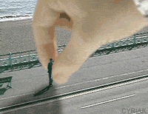
SOMETIMES IT MAY FEEL LIKE THE SYSTEM IS DOING
this to you...
Be strong and keep going on! !
DEPARTMENT OF HEALTH
MPUMALANGA PROVINCE
REPUBLIC OF SOUTH AFRICA

Slide 17

Always remember that Organisational effectiveness begins with Individual Responsibility……
Notes:
17

Slide 18

FOCUSED, MOTIVATED, INNOVATIVE,ORGANISED AND EFFICIENT
YES!
We can and we will
DEPARTMENT OF HEALTH
MPUMALANGA PROVINCE
REPUBLIC OF SOUTH AFRICA

Slide 19

Thank – you for listening!
“Work joyfully and peacefully , knowing that right thoughts and right efforts will inevitably bring about
right results”.
- James Allen
DEPARTMENT OF HEALTH
MPUMALANGA PROVINCE
REPUBLIC OF SOUTH AFRICA

