Slide 1
IDEAL CLINIC PROGRAMME
Ideal clinic Dashboard Version 15
Presenter: MNR: KGWITI MAHLAKO
Date: 15 SEPTEMBER 2015

Slide 2
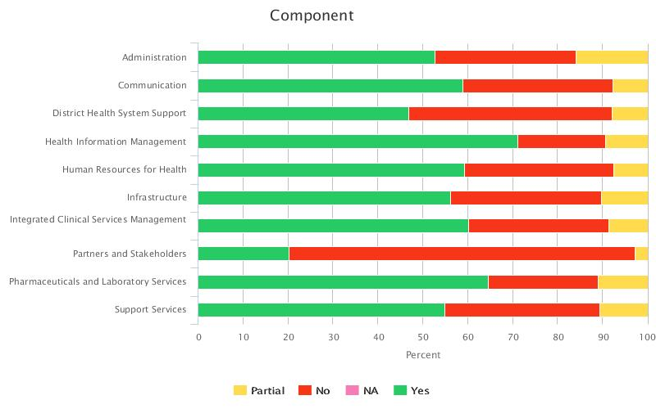
Performance per component nationally

Slide 3
4. Human Resources for Health
14. Staff allocation and use
Elements |  | W | MM | R
94 | Staffing needs have been determined in line with WISN | I | ?& | D
95 | Staffing is in line with WISN | I | & | D
96 | A dedicated facility manager must be appointed for a facility with a workload of more than 150 clients per day and who will perform at least 80% of management work per week | E | & | D
97 | Daily work allocation documentation is signed by all staff members. | I | & | HF
98 | Leave policy is available | I | & | HF
99 | An annual leave schedule is available | I | & | HF
100 | Basic Staff records are available (vacation/sick/accouchement/ family responsibility leave/study leave/suspension) | I | & | HF

Slide 4
4. Human Resources for Health
15. Professional standards and PMDS
Elements |  | W | MM | R
101 | There is an individualised Performance Management Development System for all staff members | I | & | HF
102 | Continued staff development needs have been determined for the current financial year and submitted to the district manager | I | & | HF
103 | Training records reflect that planned training according to the district training programme was conducted | I | & | HF
104 | The disciplinary procedure is available | I | & | HF
105 | The grievance procedure is available | I | & | HF
106 | Staff satisfaction survey is conducted once per year | I | & | D
107 | The results of the staff satisfaction survey is used to improve the work environment | I | & | HF

Slide 5
4. Human Resources for Health
16. Availability of Medical, Mental health, and Allied practitioner
Elements |  | W | MM | R
108 | Clients have access to a medical practitioner | E | & | HF
109 | Clients have access to oral health service | I | ?& | D
110 | Clients have access to occupational therapy services | I | ?& | D
111 | Clients have access to physiotherapy services | I | ?& | D
112 | Clients have access to dietetic services | I | ?& | D
113 | Clients have access to social work services | I | ?& | D
114 | Clients have access to radiography services | I | ?& | D
115 | Clients have access to ophthalmic service | I | ?& | D
116 | Clients have access to mental health services | E | ?& | D
117 | Clients have access to speech and hearing services | I | ?& | D

Slide 6
7. Health Information Management
25. DHIS
Elements |  | W | MM | R
177 | Facility performance in response to burden of disease of the catchment population, is displayed and is known to all clinical staff members. | I | ?K | HF
178 | Current disease trends inform prioritization of health care plans | I | & | HF
179 | District Health Information Management System policy available | I | & | HF
180 | Relevant DHIS registers are available and are kept up to date | I | ?K | HF
181 | There is a functional computerized patient information system | I | ?H | D

Slide 7
8. Communication
26. Internal communication
Elements |  | W | MM | R
182 | There are district quarterly facility performance reviews meetings | I | & | D
183 | There is at least a monthly staff meeting within the facility | I | & | HF
184 | Staff members demonstrate that incoming policies and notices have been read and are understood by appending their signatures on such policies and notifications | I | & | HF

Slide 8
8. Communication
27. Community engagement
Elements |  | W | MM | R
185 | There is a functional clinic committee | I | & | P
186 | Contact details of clinic committee members are visibly displayed | I | K | HF
187 | There is an annual open days facilitated by the clinic committee | I | & | HF

Slide 9
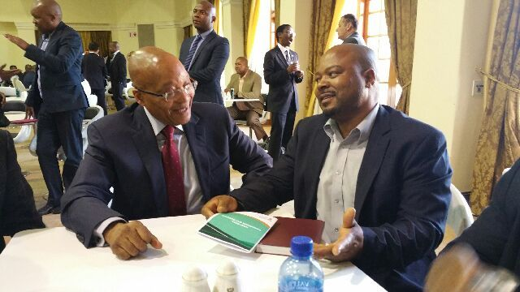
Media briefing , 13 August 2015 ( Health Operation Phakisa Progress report to the citizens of South Africa)

Slide 10
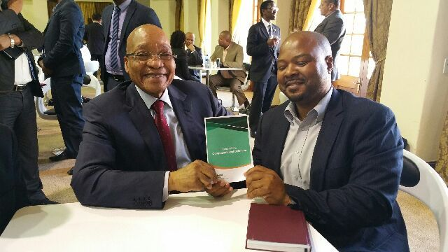
Media briefing , 13 August 2015 ( Health Operation Phakisa Progress report to the citizens of South Africa)

Slide 11
Thank YOU

