Slide 1
PPTICRM ORIENTATION
MS Y MOKGALAGADI
DATE 14 - 17 SEPTEMBER 2015

Slide 2
COMPONENT 9

Slide 3
9. DHS Support
29. Planned and Emergency patient transport
Elements |  | W | MM | R
190 | There is a pre-determined ambulance response time to the facility | I | ?& | D
191 | Ambulances respond in line with the pre-determined response time | I | & | D
192 | There is effective planned patient transport to and from the referral hospitals | I | & | D

Slide 4
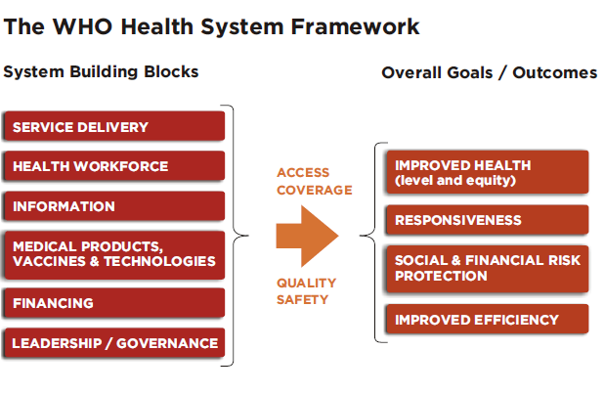
PATIENT

Slide 5
Integrated Planning Framework
Quality Improvement
Demand
Supply
Gap Analysis
Demographic
  Popdens (rurality + urban)
  Migration
  Boarder crossings
  Uninsured pop
2. Socio Economic
Poverty
Employment
Water
Sanitation
Housing
  Development (e.g.Mining)
  Tourism
3. Diseases Burden/ Health Information
Child Health
Maternal Health
HIV and AIDS
TB
NCD
  Province Specifics (Waterborn diseases, Malaria)
Access
  Location
  Infrastructure
  Package
Health Status/ profile
Equity
Service Delivery Platform – Organisation of Services, facilities, health technology and HR
Package of Services
Health Service Delivery
Platform
Financing and
financial management
Health Workforce
Action Research
Stewardship
and Governance
Norms and
Standards
Stakeholder Consultation and Communication

Slide 6

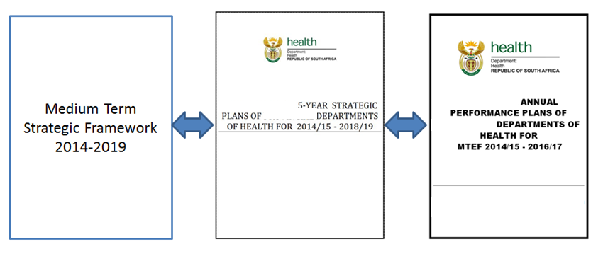
HEALTH SECTOR PLANNING HORIZON
2015/16 OPERATIONAL PLANS

Slide 7
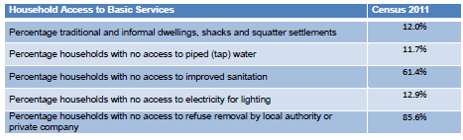
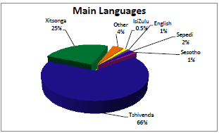

Slide 8
9. DHS Support
28. DHS
Elements |  | W | MM | R
188 | There is a health facility operational plan in line with district health plan | I | & | HF
189 | The Permanent Perfect Team for Ideal Clinic Realisation and Maintenance visits the clinic at least twice a year to record the Ideal Clinic Realization status and to correct weaknesses | E | ?& | D

Slide 9
9. DHS Support
30. Referral System
Elements |  | W | MM | R
193 | The National Referral Policy is available | I | & | NDoH
194 | The facility's Standard Operating Procedure for referrals is available | I | & | HF
195 | Referral pathways are clearly determined | I | & | D
196 | There is a referral register that records referred clients | I | & | HF
197 | Referral records indicate feedback from destination facilities | I | & | HF
198 | There is a standard National Referral form that is used by all for referring clients | I | & | NDoH
199 | Analysis of referral data is conducted to identify service delivery gaps | I | & | HF

Slide 10
COMPONENT 10

Slide 11
The Ideal PHC Facility
Mental Health Unit
Specialist NCD care
Specialist Hospital care
Emergencies
MDR-TB Control
Obstetrics
Surgery
Good Governance
Leadership Management
PHC Facilities
Quality, comprehensive, person-centred care
Provincial Support
School Health
EMS and ambulatory transport
DCSTs
Social services
Training
Ward-based PHC Outreach
Env Health
NGO services
Research Institutions
Diagnostic services
Contracted service providers
Health Campaigns
Laboratories
Universities
Community
Imaging
Research Councils

Slide 12
10. Partners and Stakeholders
31. Implementing Partners
Elements |  | W | MM | R
200 | There is an up to date list (with contact details) of all implementing partners that support the facility | I | & | HF
201 | The list of implementing health partners shows their areas of focus and business activities | I | ?& | HF
202 | Implementing health partners perform in relation to their focus area and business activities | I | ?& | HF

Slide 13
The Main Determinants of Health

Slide 14
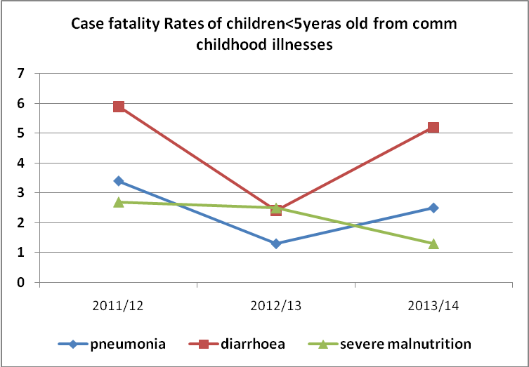

Slide 15
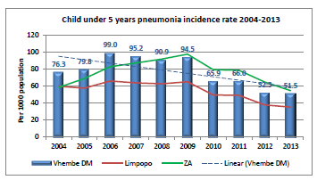
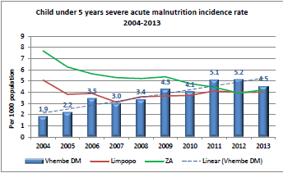
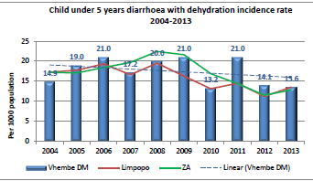

Slide 16
10. Partners and Stakeholders
32. Multi-sectoral collaboration
Elements |  | W | MM | R
203 | There is an official MOU between the PDOH and SAPS | I | & | P
204 | There is an official MOU between the PDOH Department of Education | I | & | P
205 | There is an official MOU between the PDOH and the Department of Social Development | I | & | P
206 | There is an official MOU between the NDOH and Department of Home Affairs | I | & | NDoH
207 | There is an official MOU between the PDOH and Local Government | I | & | P
208 | There is an official MOU between PDOH and Department of Water and Sanitation | I | & | P
209 | There is an official MOU between the PDOH and Department of Public Works | I | & | P
210 | There is an official MOU between the district management and Cooperative Governance and Traditional Affairs (CoGTA) | I | & | D
211 | There is an official MOU between the PDOH and department of transport | I | & | P
212 | There is an official MOU between the District management and relevant NGOs | I | & | D

Slide 17


