Slide 1


Ideal Clinic Peer review Feedback presentation
Date: 21.04.2016
Venue: Birchwood hotel
FREE STATE HEALTH

Slide 2

Presentation outline
Free state guests districts
Free State reviewing teams
Preparatory events/comments before peer reviews
Travelling arrangements
Events during peer reviews
Availability of resources
What went well during the peer review
What went wrong during the peer review
Experience of Peer Review in general
Additional Comments

Slide 3
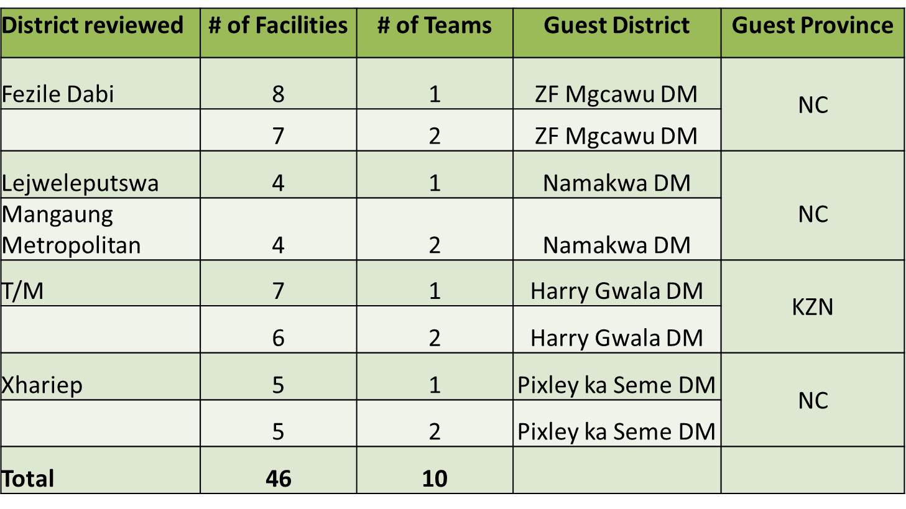
FS Guests Districts

Slide 4
FS Reviewing Teams
Province | Host District | Guest District
Mpumalanga | Nkangala District | Fezile Dabi
 | Gert Sibande District | Fezile Dabi
 | Ehlanzeni District | Lejweleputswa
 | Nkangala District Gert Sibande District | Lejweleputswa
North West | Dr Ngaka Modiri Molema | Mangaung Metro
 | Dr Ngaka Modiri Molema | Mangaung Metro
North West | Bojanala District | Thabo Mofutsanyane
 | Bojanala District | Thabo Mofutsanyane
Northern Cape | Namakwa District | Xhariep
 | John Taole Gaetsewe District | Xhariep

Slide 5
Comments on preparatory events/issues before peer review started on 1 February 2016
  September 2015 meeting:
The meeting was well organized.
Teams understood the Ideal clinic assessments tools and what evidence to look for when conducting status determination.
Teams were able to learn good practices from other districts.
NDoH requested some of the participants to use their own transport and submit claims to department. Forms were filled and submitted and to date no payments has been effected.
  December 2015 meeting:
The meeting was a success.
The reviewing teams had an opportunity to plan together with host districts and agreed on routes to different facilities, transportation and accommodations.
The messages were well communicated prior to the meeting.
Issues about the interpretation of the standards set in the manual, checklist and dashboard were discussed at length and agreed upon.

Slide 6
Comments on preparatory events/issues before peer review started on 1 February 2016
  Software preparation
Ideal Clinic Software was accessible and easy to work on.
Modems were never delivered and the teams used their own.
  Communication to peer reviewers before assessments started (1 February 2016)
The reviewers were given clear messages as to where they will be going and who to meet as their contact person in host districts.
Communication was good and every message received was acknowledged but lunch was not provided to some of teams as they had been informed.
  Other comments on preparation
Follow ups were done where communicated information was unclear.
Preparation was satisfactory for some of the teams although they requested new manuals and checklists be circulated early to the districts concerned.

Slide 7
Arrangement for travel to peer review district and return trip - I
    Shuttle service
    Some the teams did not use shuttle service but those that did, had a good experience except for Xhariep District which had transportation problems from the airport to their intended accommodation.
    Flight tickets
    Flight tickets details were communicated to all team members individually on time so there were no hassles.
    Car Hire
The cars were delivered as scheduled for most of the teams except for Xhariep District which had to wait 8 hours after arriving at the airport.
The team from Thabo Mofutsanyane had a flat tire. The matter was communicated to the NDoH logistic team but the problem was never resolved. The team was forced to fix the puncture at their own expense.
On the 9th of February the petrol card for one team was stopped and the team had to fill the fuel out of their own pocket.

Slide 8
Arrangement for travel to peer review district and return trip - II
    Accommodation and meals
The teams received accommodation details via their cellphones on Sunday the 31 January 2016.
The meals at that hotel were very good, although on Monday and Tuesday some teams did not have lunch boxes – one facility prepared food for the reviewing team.
Accommodation arrangements for other teams were not well organized:
  One team arrived at the Hotel around 18h30 but were only accommodated after midnight. (“we had to go and get dinner from nearby restaurant on that night and that was a very risky”)
  The team from Xhariep district waited about 3 hours before being accommodated (no payments from the travel agency and can therefore not be accommodated)
  One team had no accommodation and was forced to sleep in the car at the petrol station. (“we had no dinner nor breakfast and had to bath at the garage to carry out the duties of the day”).

Slide 9
Comments on events / issues during the peer review
    Contact person on arrival
    Most of the teams had a person who accompanied them to facilities
    One team struggled to get facilities and was lost (“we had to pay Toll gate fee of which we were not supposed to go to that area”)
    The other team was fetched from the hotel by the Primary Health Care Manager of Nkangala District.
    The team received a welcoming letter from the HOD of the Health in the Province.
    Visit to the facilities
One team was fetched every morning by the District Coordinators of Nkangala District to the facilities that were going to be assessed.
The welcoming at all the facilities were humbling. (“Everyone treated us with respect, we really felt like ROYALS”)
    Interaction with facility managers
  Most of the teams indicted that the facility managers were very supportive and very cooperative.
  Lunch was prepared for us by the staff of all the 8 facilities we assessed. A humbling gesture in deed that the team will always cherish.

Slide 10
Availability of resources for peer review February 2016 - I
    Hard copy of peer review instrument
    No problems were encountered and all necessary Peer Review tools were available to the teams
    Data capture (modem, SIM, Data bundle, network availability)
Some teams used their own modems as NDoH had not provided them as promised.
Only one modem was available, so the teams had to share it and that led to delays in capturing resulting in - Team members working until very late in the night,
- Facilities not given results immediately after the assessment as expected
An additional modem from NDoH only arrived days after peer reviews were conducted.
The team from Xhariep found the capturing of the status determination time consuming.

Slide 11
Availability of resources for peer review February 2016 - II
    Ideal clinic software (access, data upload and support)
In one instance, the team struggled to upload the status determination for about two hours but then later the problem was resolved.
The software was available, though occasionally the teams experienced problem accessing it.
Some important emails were not delivered on time (possibly due to bad connection).
  Any other comments on Peer Review
All resources to be used during Peer Review must be sent to District two weeks before reviews commence.

Slide 12
What went well and should be part of future peer reviews
  During Preparatory Phase
  The workshop that was conducted in December 2016 for planning by all teams was a success. To have briefing sessions before Peer Reviews
  Good communication by Ideal Clinic Team.
  Support given by National and Provincial technical support teams.
  During peer review period
  NDoH to follow up assessors every day to find out if everything is still going well
  One facility should be assessed each day as the tool is very long and makes it nearly impossible to assess more than one facility.

Slide 13
What went wrong and should be improved on in future peer reviews
  During Preparatory Phase
  Resources were not sent on time (modems)
  Specifications sent to Hotels for accommodation need to be clear and sent well in advance so that hotels know what to give
  Funds be allocated for toll gates where necessary
  Directions to facilities should be provided to the PPTICRM teams
  During peer review period
  Only two people were handling issues from all provinces and this led to teams being frustrated as the responses were slow sometimes none
  Teams should be accompanied by people who are very familiar with the proposed area to be assessed.
  Some of the assessors had a different view on how to score marks.
  - It is recommended that all the assessing teams must have the same understanding of requesting evidence at facilities.

Slide 14
Experience of Peer Review in general
It was a mixture of bad and good experiences.
Good Experiences
  The reviews gave the assessing teams an opportunity to learn good practices from other provinces on how to achieve Ideal Clinic status.
Bad Experiences
  Some of the teams spent many hours before accommodated at hotels awaiting confirmations
  No lunch boxes were arranged with hotels as promised
  Some had no accommodation at all
  Modems were delivered when the assessment was completed
  Reception at some hotels was not welcoming and in some instances there was no food arranged for the teams
  Teams had to use their own money to buy food, fuel and pay toll gates.

Slide 15

Additional Comments
The teams suggest that Cross districts Peer Reviews must be conducted annually.
Despite the hiccups experienced, the teams feel that this was a good learning opportunity.
Communication in responding to issues/challenges during peer reviews must be improved.
Logistics preparations must be improved for future peer review
All assessors must meet and agree on criteria for assessments.

Slide 16
Thank you

