Slide 1


^{when the sun rises}
^{we work hard to deliver}
MPUMALANGA PEER REVIEW FEEDBACK
BIRCHWOOD HOTEL
21 APRIL 2016

Slide 2
Presentation Layout
Mpumalanga Team
Preparatory activities before the peer reviews started
2. Comments on events issues during the actual peer reviews
3. What went well/ best practices and should be part of future peer reviews
4. What went wrong and should be improved in future peer reviews
5. Good or bad experiences of peer reviews in general
Additional comments
Lessons Learnt

Slide 3
MPUMALANGA TEAM ASSESSED KZN
DISTRICT | HOST DISTRICT | NO OF FACIILITIES
Ehlanzeni | eThekwini MM | 14
Gert Sibande | Uthungulu DM | 14
Nkangala | Zululand | 13

Slide 4
Preparatory activities before the peer reviews started
The meeting held at Birchwood in September 2015 aimed at calibrating/ standardizing the Ideal Clinic Realization and Maintenance tools.
The meeting was effective in providing orientation and also provided a platform for benchmarking of best practices
Planning for peer review teams at that stage was not adequate
Inadequate time was spent on the actual ICRM tools
Provinces were to a certain extent capacitated on the use of ICRM software
Changes made to vital, essential and important were reflected

Slide 5
Preparatory activities before the peer reviews started cont’
The meeting conducted in December 2015 was very effective in the planning process for the peer reviews.
The maps that were printed provided good information with regard to the planning process and the distances to be travelled.
The briefing sessions between the host and the reviewing districts provided a good opportunity for proper planning.
This process enabled the NDoH to be efficient in finalising the arrangements for the peer reviews

Slide 6
1. Preparatory activities before the peer reviews started cont’
The software was not prepared on time and there was continuous amendment of the interpretation of the dashboard.
Communication to peer reviewers was constant and effective
As part of preparation going forward, the peer reviewers are to have a dress code, e.g. name tags and formal dress

Slide 7
2. Comments on events / issues during the actual peer reviews
Positive
Transport was well arranged
Cars delivered on time and there were no problems
Support by host districts was very good (PHC and hospitals supportive of each other)
Negative
Data capturing (modem, SIM, data bundle, network availability were a challenge)
Peer reviewers were not provided with lunch packs
Accommodation should at least have a bar fridge

Slide 8
3. Comments on events issues during the actual peer reviews cont’
  Actual Peer Review
  Access to the server was on and off resulting in delays and loss of data
  Lack of modems, adequate skill impacted on the online capturing
  Best Practices
  Transport arrangements
  Support from the NDoH and the host districts

Slide 9

4. What went wrong and should be improved in future peer reviews
  Accommodation arrangements (no lunch packs, no bar fridges)
  Lack of modems, data bundles, network and SIM cards
  Lack of communication of high risk areas (vehicle high jack)
  Capturing online was a challenge

Slide 10
5. What was good or bad experiences of peer reviews in general
Positive experience:
The peer review process was a good learning experience ( “Steal shamelessly and share selflessly”)
Benchmarking and imparting of good practices
Negative experience:
Long working hours due to the workload
Exposure to risky areas

Slide 11
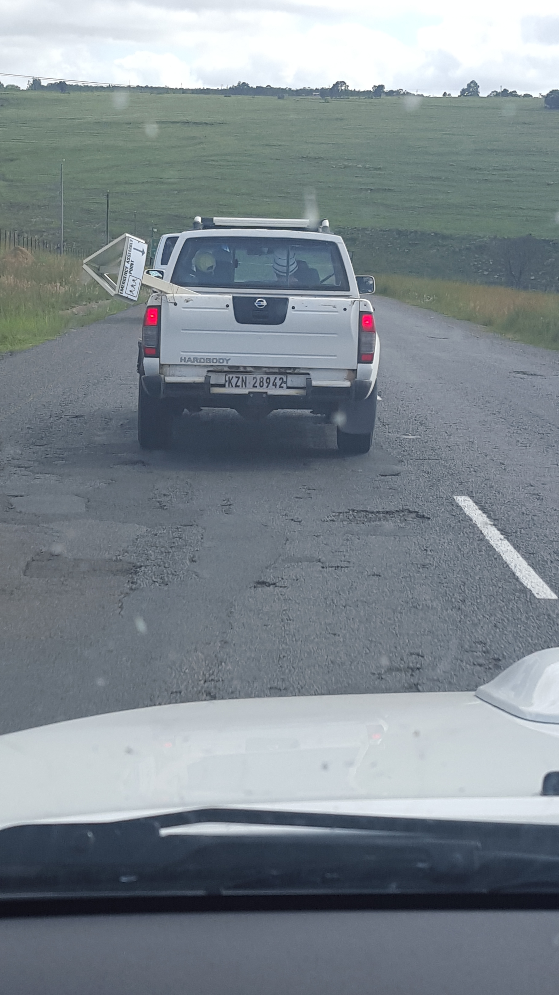
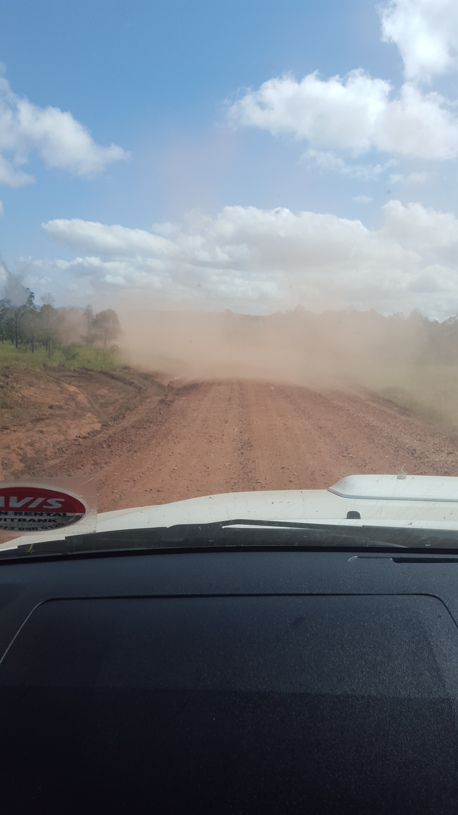
Commitment at the highest level

Slide 12
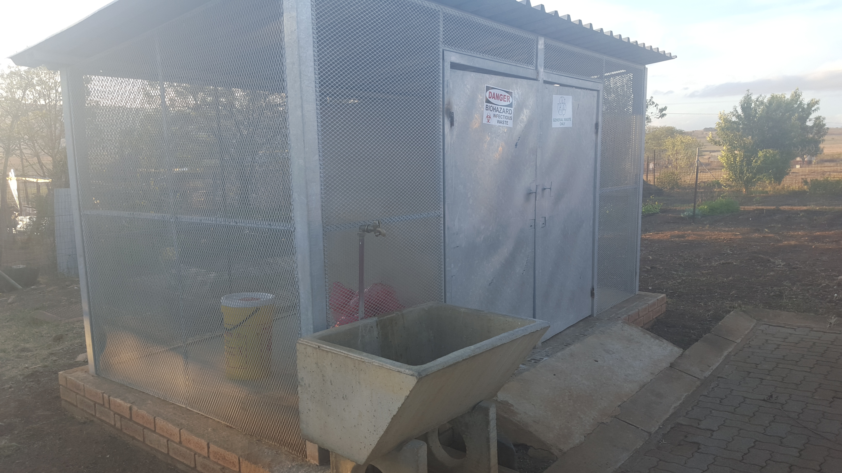
Best Practices: Medical Waste Storage

Slide 13
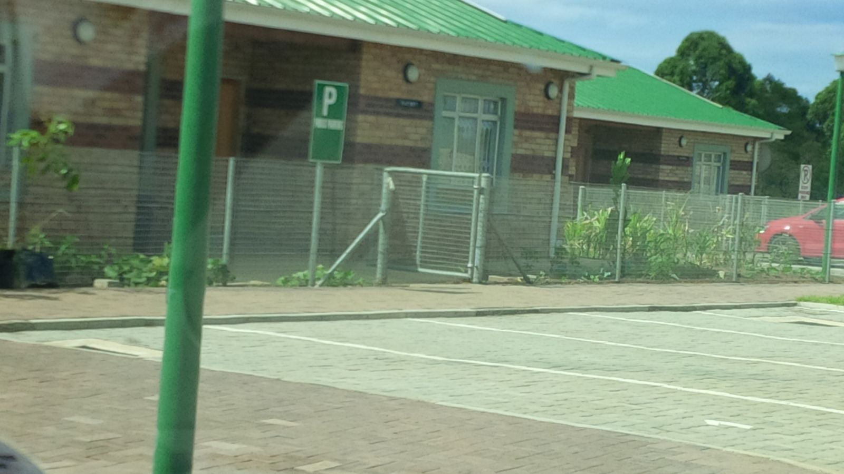
5. What was good or bad experiences of peer reviews in general
Good infrastructure – Well designated parking

Slide 14
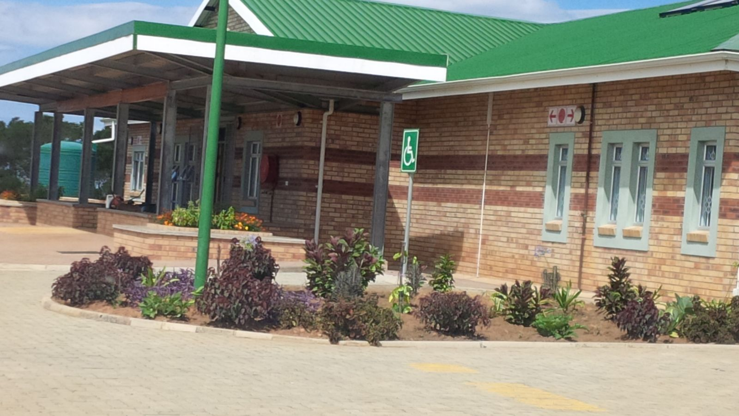
5. What was good or bad experiences of peer reviews in general
Good Infrastructure and Landscaping

Slide 15
6. Any additional comments
  Conscientise reviewing districts on high risk areas (vehicle high jack and violent areas)
  Uniform identification of peer reviewers recommended
  Off line capturing recommended - network challenges
  Feedback to the respective District Management / Provincial Management Teams
  NDOH commitment to the process is commendable

Slide 16

Lessons Learnt from KZN
Good Team work
High level of support from Management and CEO’S from hospitals
Emergency rooms well equipped
Good infrastructure

Slide 17




Thank – you for listening!
“Work joyfully and peacefully , knowing that right thoughts and right efforts will inevitably bring about
right results”.
- James Allen
DEPARTMENT OF HEALTH
MPUMALANGA PROVINCE
REPUBLIC OF SOUTH AFRICA

