Slide 1

National Guideline for Patient Safety Incident Reporting and Learning
Provincial Quality Assurance workshops
Quality Assurance
COO’s Office
Ronel Steinhöbel
7 December 2017

Slide 2
Contents
  Background
  Purpose
  Legal and policy framework
  Scope
  Definitions
  Mandatory requirements
  Committees
  Minimum Information Model
  Steps to manage Patient Safety Incidents
  Web-based information system
  Monitoring and Evaluation

Slide 3

National Guideline for Patient Safety Incident Reporting and Learning
Soft copy available for download: www.health.gov.za
Hard copies distributed to provinces by middle of January 2018

Slide 4
Background
The Guideline was developed to comply with:
World Health Organization’s (WHO) call that all countries should have a national system for PSI reporting and learning
The recommendation made by the Medico-Legal Summit , hosted by the Minister of Health in March 2015, that called for a uniform National Reporting System for Adverse Events

Slide 5
Purpose
The purpose of the Guideline is to:
Provide direction to the public health sector of South Africa regarding the management of Patient Safety Incident (PSI) reporting,
Give guidance on appropriate feedback to patients, families/support persons and clinicians, and
Share lessons learned to prevent patient harm.

Slide 6
Legal and policy framework
National Health Act no 61 of 2003
The National Health Amendment Act 12 of 2013
Ethical rules for health practitioners
The National Patients’ Rights Charter
The Health Professions Amendment Act 29 of 2007
The Births and Deaths Registration Act 51 of 1992
The Inquest Act (as amended)
The Mental Health Care Act 17 of 2002
Medicines and Related Substances Act, 1965 (Act 101 of 1965) as amended
National Health Act, 2003 (Act 61 of 2003) - Regulations relating to blood and blood products (no.r.179)

Slide 7
Scope
Applies to:
Public health establishments of South Africa.
Clinical staff and non-clinical staff
Defines:
Roles and responsibilities
Mandated reporting requirements
Timeframes
Facility/district/provincial and national level processes for aggregation, analysis, learning and action on incidents

Slide 8
Definitions
  Patient Safety Incident (PSI) is:
  an event or circumstance that could have resulted, or did result in unnecessary harm to a patient
  PSI include:
  harmful (adverse events)
  near misses and
  no harm incidents

Slide 9
Mandatory requirements
All health facilities must have a system in place to manage PSIs according to the following principles:
Just Culture
Confidential
Timely
Responsive
Openness about failures
Emphasis on learning

Slide 10
Implementation through Committees
  Patient Safety (PS) Committees:
  Terms of Reference for Provincial PS Committees Develop provincial policy/protocol/guidelines
  Terms of Reference for Hospital and Sub-district/district PS Committees Develop hospital/district SOP
  Terms of Reference for National PS Committee
Gives guidance to PS Committees on the designation of the members to include in their committees.

Slide 11
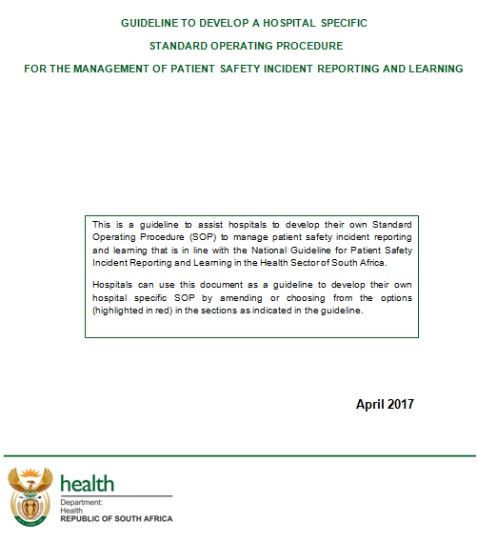
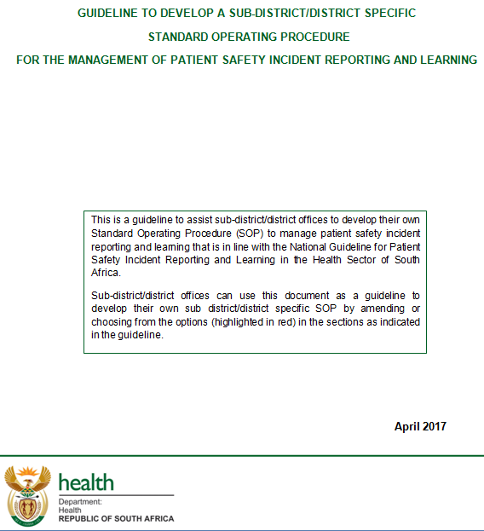
Guidelines to develop hospital, and sub-district/district SOP

Slide 12
Minimum Information Model
Uniform Classification system according to WHO’s Minimum Information Model (MIM) for PSI reporting to ensure that data is uniform to enhance learning
Classification according to:
Incident identification (Patient information, time, location and agents involved)
Incident type
Incident outcomes
Resulting actions
Reporter

Slide 13
Management of PSI
Steps to follow for the management of PSI:
Step 1: Identifying PSIs
Step 2: Immediate action taken
Step 3: Prioritisations
Step 4: Notification
Step 5: Investigation
Step 6: Classification
Step 7: Analysis
Step 8: Implementation of recommendations
Step 9: Learning

Slide 14
Step 1 - Identifying PSIs
Patient safety incident reporting by health professionals
Inpatient medical record review / retrospective patient record review
Focus teams
External sources
Review of record on follow-up of patients
Surveys on patients’ experience of care
Safety walk rounds
Use data to identify and guide management of patient safety incidents
Research studies and findings

Slide 15
Step 2 - Immediate action
Actions may include:
providing immediate care to individuals (patient, staff or visitors) to prevent the harm from becoming worse
making the situation/scene safe
gathering basic information from staff while the details are still fresh
notify South African Police Service (SAP), health establishment’s security or other institution where applicable

Slide 16
Step 3 - Prioritisation
3 classes in the Severity Assessment Code (Annexure E)
SAC 1 - includes incidents where serious harm or death occurred.
SAC 2 - includes incidents that caused moderate harm
SAC 3 - includes incidents that caused minor harm

Slide 17
Step 3 (cont) – Severity Assessment Code (SAC)
 | SAC 1 | SAC 2 | SAC 3
Actual/ potential consequence to patient | Serious harm or death that is/could be specifically caused by healthcare rather than the patient’s underlying condition or illness | Moderate harm that is/could be specifically caused by healthcare rather than the patient’s underlying condition or illness | Minor or no harm that is/could be specifically caused by healthcare rather than the patient’s underlying condition or illness
Type of event/ incident | Wrong patient or body part resulting in death or major permanent loss of function Retained instruments/other material after surgery Wrong surgical procedure Surgical site infections that lead to death or morbidity Suicide of a patient in an inpatient unit Death or serious morbidity due to assault or injury Nosocomial infections resulting in death or neurological damage Blood transfusion that caused serious harm or death Medication error resulting in death of a patient Adverse drug reaction (ADR)that results in death or is life-threatening Maternal death or serious morbidity Neonatal death or serious morbidity Missing/swopped/abscond patient and assisted or involuntary mental healthcare user/mental ill prisoner/State patient Any other clinical incident which results in serious harm or death of a patient | Incidents include but are not limited to the following: Moderate harm resulting in increased length of stay (More than 72 hours to seven days) Additional investigations performed Referral to another clinician Surgical intervention Medical intervention Moderate harm caused by a near miss ADR that resulted in moderate harm Blood transfusion reaction that resulted in moderate harm | Incidents include but are not limited to the following: Minor harm resulting in increased length of stay of up to 72 hours No harm Only first aid treatment required Near miss that could have resulted in minor harm ADR that resulted in minor or no harm Blood transfusion reaction that resulted in minor or no harm

Slide 18
Step 4 - Notification
Record keeping
Patient Safety Incident Reporting Form
Patient Safety Incident Register
Incident notification to management – SAC1 Report to next line of management within 24 hours
Incident notification to patient

Slide 19
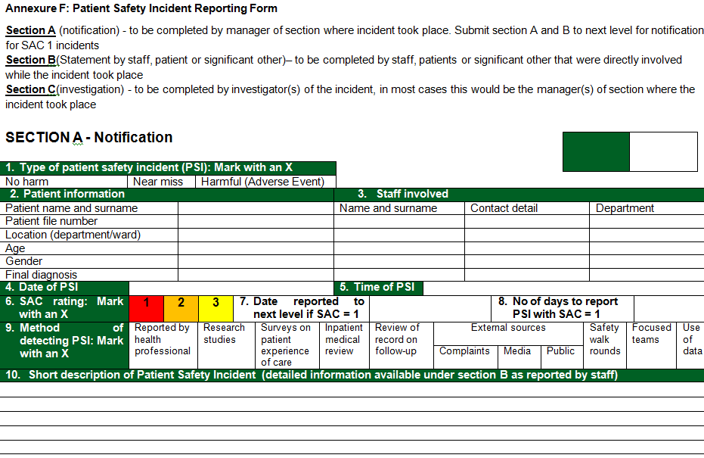
Patient Safety Incident Reporting form

Slide 20
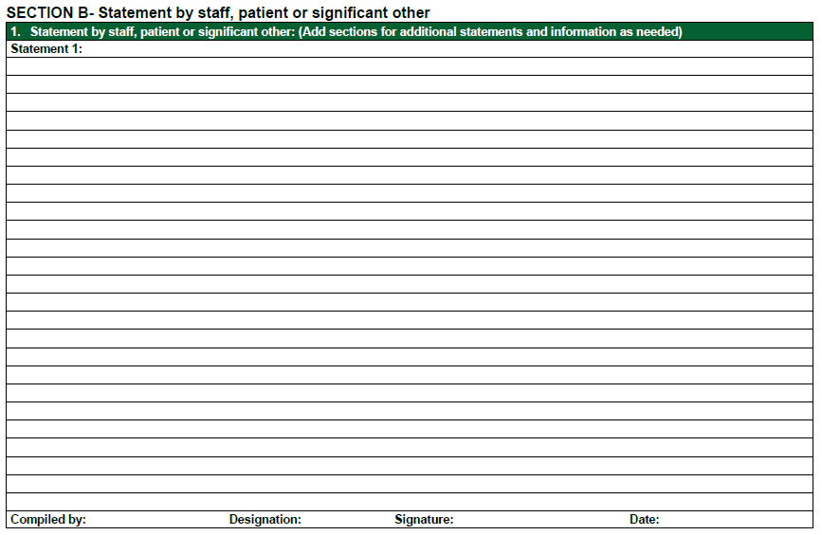
Patient Safety Incident Reporting form

Slide 21
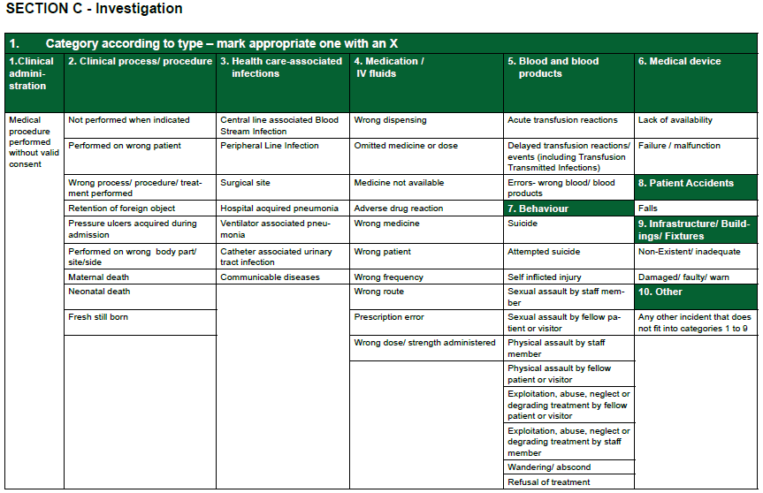
Patient Safety Incident Reporting form

Slide 22
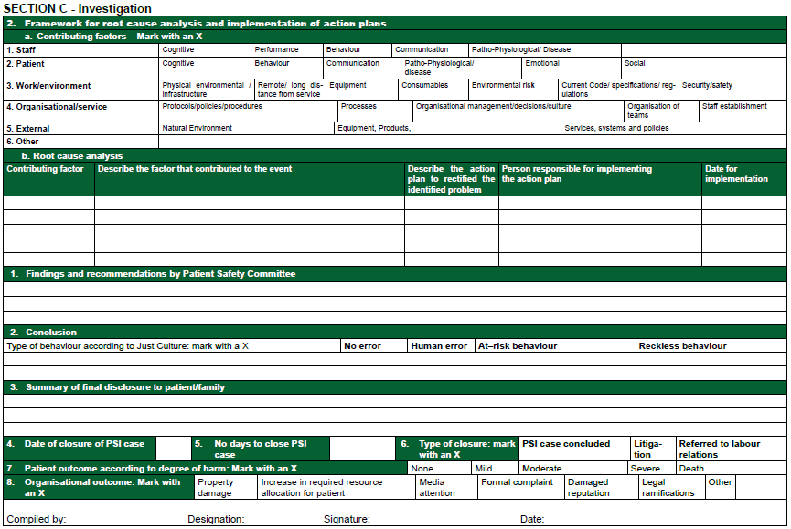
Patient Safety Incident Reporting form

Slide 23
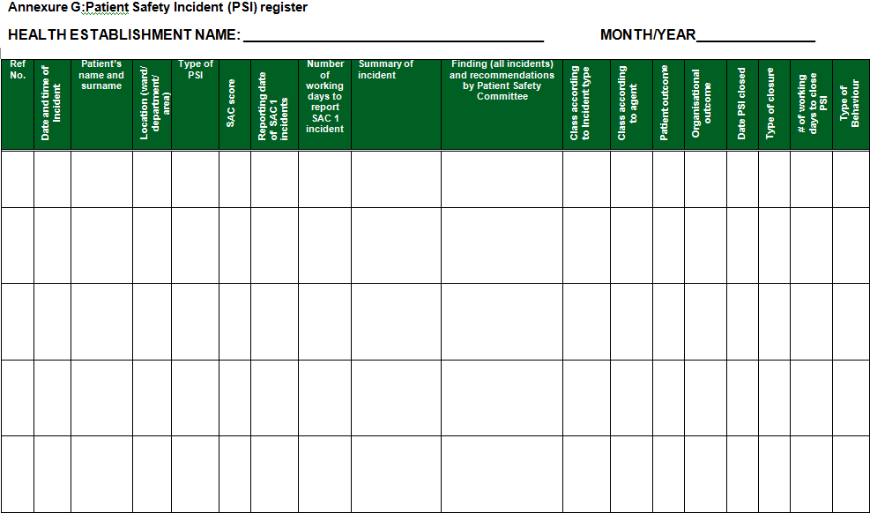
Patient Safety Register

Slide 24
Step 5 - Investigation
An investigative report should include:
detailed chronology of circumstances
summary of the interviews conducted
root cause analysis that includes the actions to be taken
conclusions by Patient Safety committee
recommendations arising from the investigation
Conclude investigation within 60 working days

Slide 25
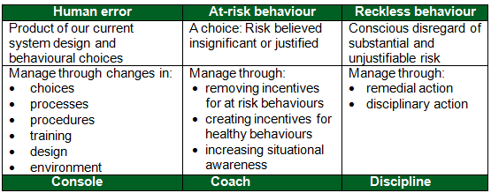
Investigation (cont) - Just Culture
Humans fail because the systems, tasks and processes in which they work and operate are wrongly designed by Dr Lucian Leape

Slide 26
Step 6 – Classification (MIM)
Classifications of agents involved – Main and sub (Annexure A)
Classifications of incident type – Main and sub (Annexure B)
Main classification for causation (agent)
Staff Factors | Patient Factors
Work/Environment Factors | Organisational/Service Factors
External Factors | Other
Main classification for incident type
Clinical process/ procedure | Patient accidents | Clinical Administration
Health Care associated infections | Medication/ IV fluids | Blood or blood products
Medical device/ equipment | Behaviour | Other
Infrastructure/ Buildings/ Fixtures

Slide 27
Classification (MIM con)
Classifications of incident outcome (Annexure C)
Patient | Organisation
None | Property damage
Mild | Increase in required resource allocation for patient
Moderate | Media attention
Severe | Formal complaint
Death | Damaged reputation
 | Legal ramifications
 | Other

Slide 28
Step 7 – Analysis
Reduce the occurrence of PSIs by analysing the data
make recommendations
implement recommendations for change
Analyse statistical data on (reporting templates):
data on classifications of agents involved, see annexure H
data on classifications of incident type, see annexure I
data on classifications of incident outcome, see annexure J
indicators for PSIs, see annexure K

Slide 29
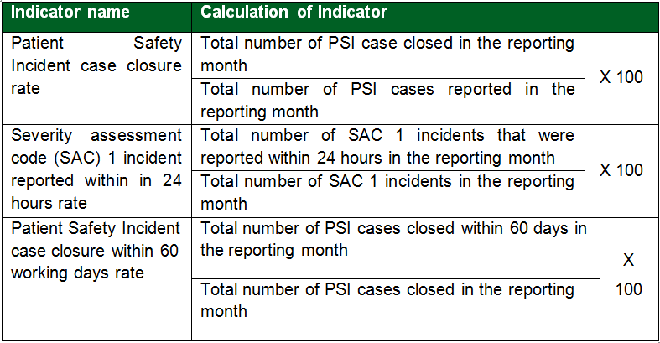
Step 7 (cont) – Indicators

Slide 30
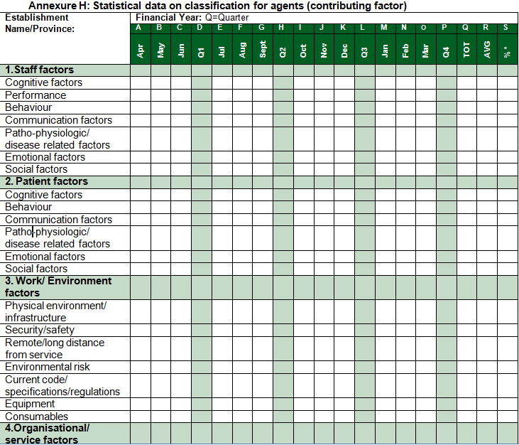
Reporting template for categories – contributing factors

Slide 31
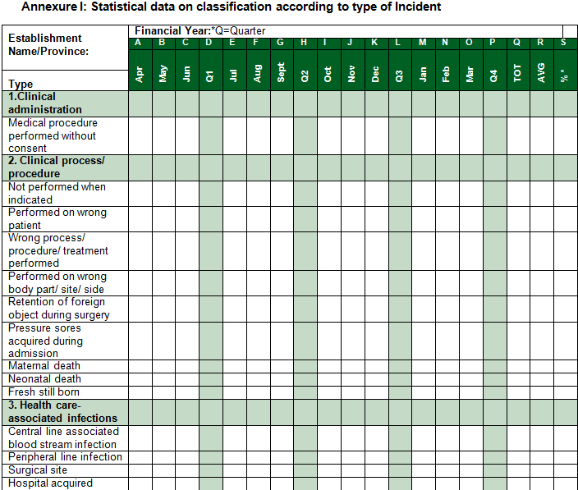
Reporting template for categories – Type of incident

Slide 32
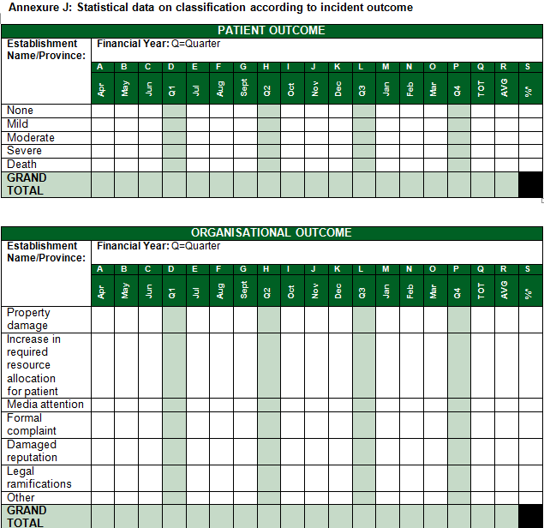
Reporting template for categories – Outcome

Slide 33
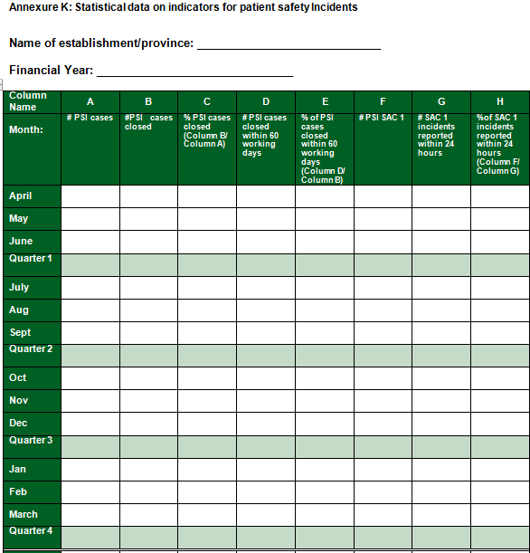
Reporting template for Indicators

Slide 34
Step 8 - Implementation of recommendations
Recommendations from the investigations and reviews to be implemented to ensure the development of better systems to ensure improved practices
The Root Cause Analysis indicates the time frames as well as the staff responsible for implementation – see PSI form

Slide 35
Step 9 - Learning
Purpose of PSI reporting systems is to enhance patient safety by learning from failures of the health-care system
Reporting can lead to learning and improved safety through:
the generation of alerts regarding significant new hazards,
feedback and
analysing reports

Slide 36

Step 9 (cont) - Learning
To make an error is human, to cover up is unforgivable, but to fail to learn is inexcusable
Sir Liam Donaldson
WHO Envoy for Patient Safety

Slide 37
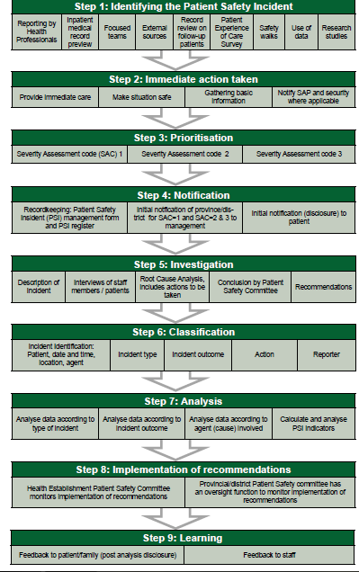
Flow diagram for action steps to manage patient safety incidents
Figure 1, page 31

Slide 38
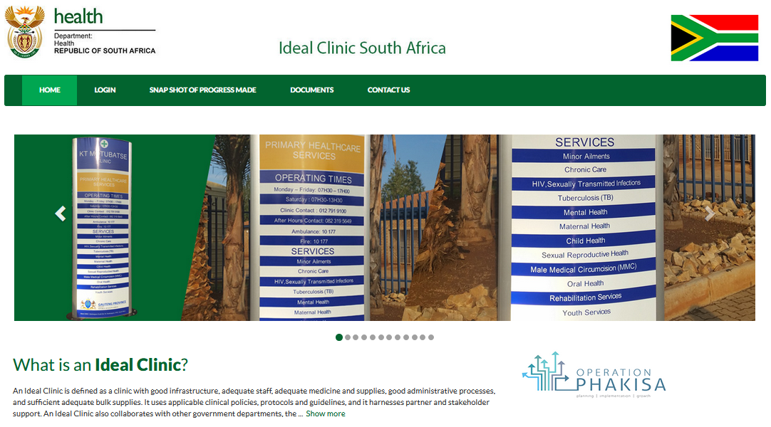
Web-based information system
https://www.idealclinic.org.za
The information system contains the prescribed form to collect data and generate reports according to the prescribed reporting format.
Helpdesk at idealclinic@health.gov.za
Access through
a user account

Slide 39
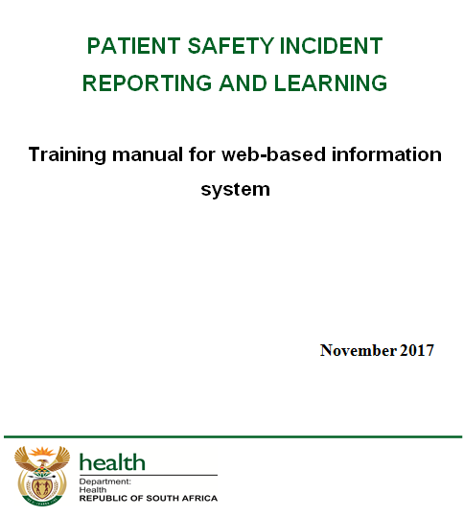
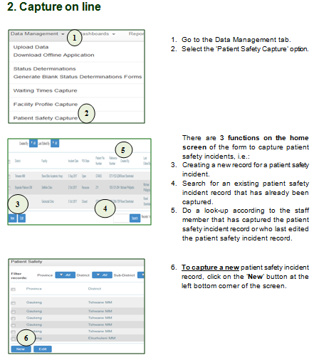
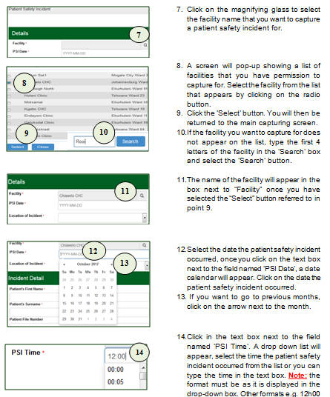
Training manual for web-based information system

Slide 40
Management of information system
Include management of web-based information system in provincial protocol/guideline/SOP
Who will have capturing rights for which levels
Who will capture PSIs that are reported at provincial/district level – be careful of duplication!
Who will be responsible for requesting user accounts
Can include responsibilities in terms of reference of committees at different levels
Indicator data on web-based information system, must be the same as the indicator data captured on DHID
Once all facilities are using the information system - will link with DHIS to automatically transfer indicator data to DHIS

Slide 41
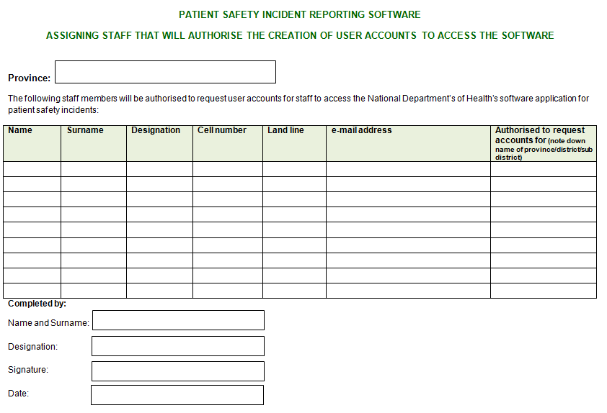
Access to Web-based information system
Every province to complete and submit a form to indicate which staff members may request user accounts from NDoH
Note: submit signed copy to ronel.steinhobel@health.gov.za

Slide 42
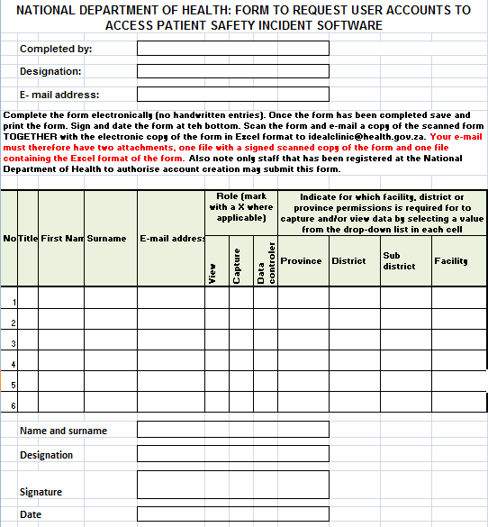
Access to Web-based information system
Only designated staff may submit the form to request user accounts to idealclinic@health.gov.za
Note: submit both scanned signed copy AND original Excel document

Slide 43
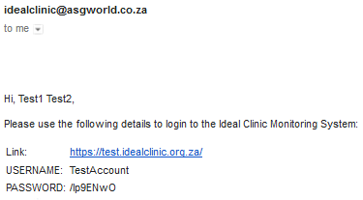
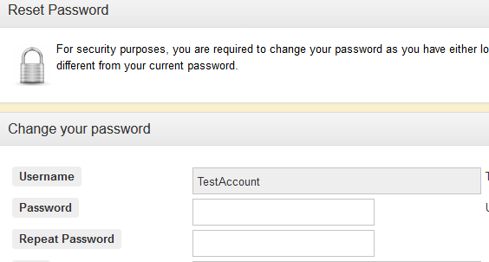
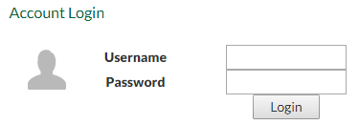
Web-based information system
Test site: https://test.idealclinic.org.za
Username: TestAccount
Password: Password789
Enter your own password twice when logging on for the first time

Slide 44
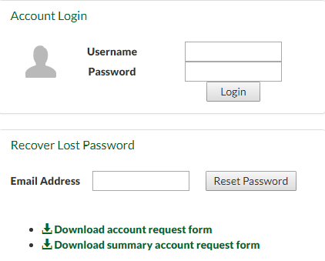

Web-based information system
What if I forgot my password?
Enter your e-mail address in the box provided, select ‘Reset Password’. An e-mail with a new temporary password will be sent.
Can also use it to verify if an account exist. If there is not an account for the e-mail address message will display

Slide 45
Monitoring and evaluation
Implemented over a 5 year period
Provinces to submit data on prescribed templates from 1 April 2018:
Classification of agents involved,
Classification of incident type
Classification of incident outcome
PSI indicators
PSI Case Closure Rate
SAC 1 Incident Reported within 24 hours Rate
PSI Case Closure within 60 working days Rate
NDoH to monitor data submitted and compile annual report

Slide 46
Monitoring and evaluation
NDoH will host in November of every year a National Quality Assurance Meeting that will be used for:
sharing provincial experiences
determining the efficacy of the Guideline
evaluating the overall national performance
Mid term review of Guideline in 30 months
Final review of Guideline in 5 years

Slide 47
Conclusion
Incident reporting must occur in conjunction with:
rigorous investigation,
methods of analysis and prioritising harms
an overall culture driven by a desire to identify systems failures rather than seeking individuals to blame
Patient safety focal person in each province

Slide 48

END
www.health.gov.za

