Slide 1

National Guideline to Manage Complaints, Compliments and Suggestions
Provincial Quality Assurance workshops
Quality Assurance
COO’s Office
Ronel Steinhöbel
Date: 8 December 2017

Slide 2
Contents
  Background
  Purpose
  Legal and policy framework
  Scope
  Definitions
  Committees
  Complaints management
  Compliment and Suggestion management
  Web-based information system
  Monitoring and Evaluation

Slide 3

National Guideline to Manage Complaints, Compliments and Suggestions
Soft copy available for download: www.health.gov.za
Hard copies distributed to provinces by middle of January 2018

Slide 4
Background
Director General approved Complaints Management Protocol in August 2014.
Decision made to revise and reshape the Protocol into a guideline document
Changes made to protocol:
Added the management of compliments and suggestions
Revised categories of complaints
Revised risk rating

Slide 5
Purpose
The Guideline was developed to ensure that:
1. Standards and measures are adhered to as set out by:
National Department of Health (NDOH),
Department of Planning, Monitoring and Evaluation in the Presidency (DPME),
Department of Public Service and Administration (DPSA)

Slide 6
Purpose (continue)
2. The right of patients and/or their families/support persons to lodge a complaint, give a compliment or make a suggestion, is upheld
3. Valuable information is gathered from which the health system could learn to improve quality

Slide 7
Legal and policy framework
The Constitution of the Republic of South Africa
The National Health Act, Act 61 of 2003 as amended
The White Paper on Transforming Public Service Delivery
Public Service Legislative Framework
Ethical rules for health providers
The National Patients’ Rights Charter

Slide 8
Scope
Applies to all complaints, compliments and suggestions that are recorded in public health establishments of South Africa,
Applicable to clinical and non-clinical staff,
Describes roles and responsibilities
Articulates mandated reporting requirements
Defines the timeframes
Identifies the facility/ district/provincial and national level processes for aggregation, analysis, learning and action

Slide 9
Definitions
  Complaint:
Is defined as the dissatisfaction, displeasure, disapproval or discontent expressed verbally or in writing by any person about the specific health services being rendered and or care being provided within the public health sector .
It does not include:
staff–specific grievances that is codified within Labour Relations legislation
complaints that relate more to broad national health policies and
complaints that relate to corruption which should be referred to the National Anti- Corruption Hotline (NACH)

Slide 10
Definitions (continue)
  Compliment:
Is any expression of praise, commendation or admiration given by any person on health services being rendered and or care being provided within the public health sector.
  Suggestion:
Is any proposal made or an idea that has been put forth by any person to improve the health services being rendered and or care being provided within the public health sector.

Slide 11
Committees
  Complaints, compliment and suggestion Committees (CCSC):
  Terms of Reference for Health establishments
  Terms of Reference for Sub-district/district
  Terms of Reference for Provincial
  Terms of Reference for National
Can form part of other committees that deal with quality improvement
Gives guidance on the designation of the members

Slide 12
Protocol/Standard Operating Procedure
Provincial offices must develop a protocol/policy/standard operating procedure (SOP)
Hospitals and district offices must have a standard operating procedure for managing complaints, compliments and suggestions that is in line with the National Guideline

Slide 13
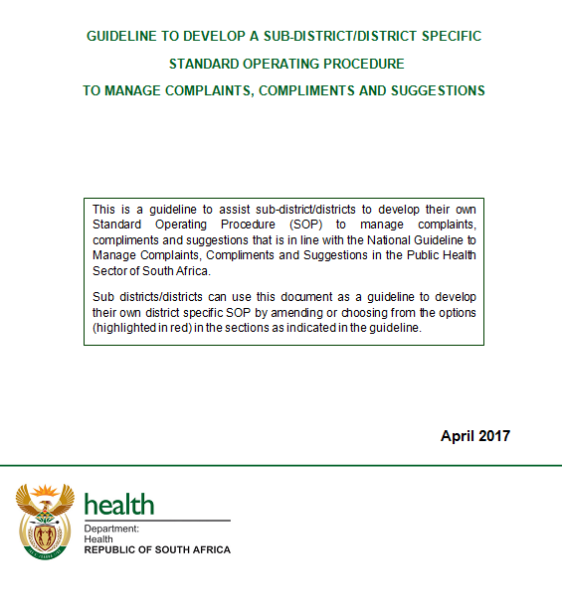
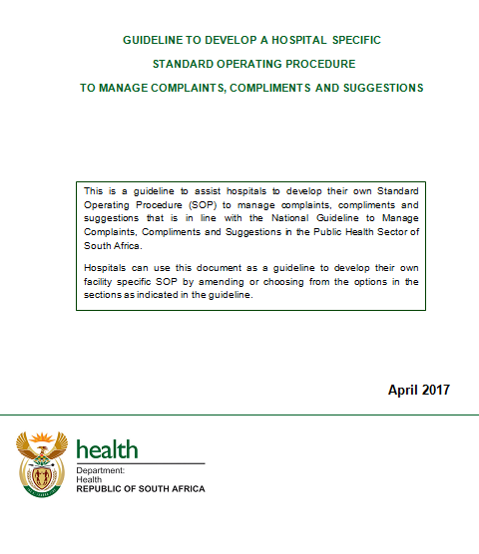
Guideline to develop a hospital and sub-district/district SOP

Slide 14
Complaints management
Three-stage system for managing complaints at
  health establishments
  district/province offices and
  external organisations e.g. Health Ombud and Public Protector
Steps to be followed to ensure that a complaint is successfully managed:
Step 1: enabling complaints
Step 2: responding to complaints
Step 3: accountability and learning

Slide 15
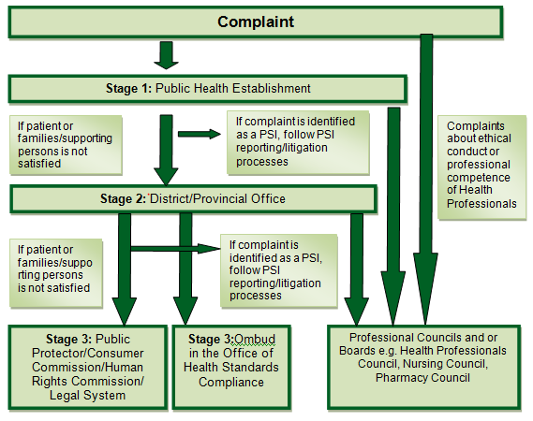



Three stage system
Ministerial directives on the time frame to resolve complaints takes priority

Slide 16
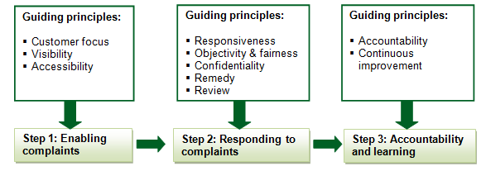
3 Steps to follow

Slide 17
Steps 1 – Enabling complaints
Arrangements that enable people to lodge complaints at health facilities:
Complaint, compliment and suggestion forms
Complaints, compliments and suggestion box
Poster

Slide 18
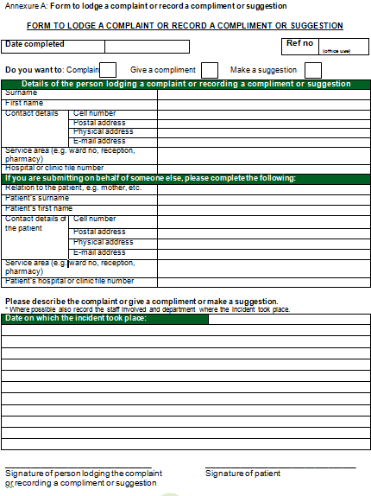
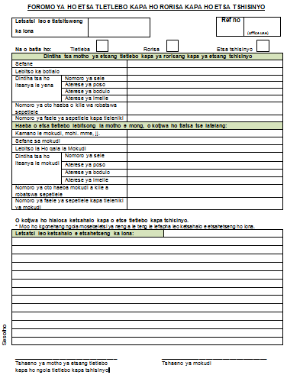
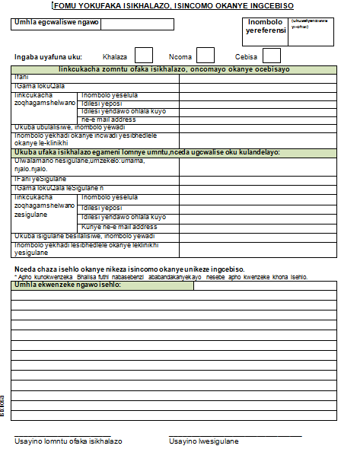
Steps 1 – Enabling complaints
Translated in 11 official languages
Investigate anonymous complaints
Not required to enable investigation

Slide 19
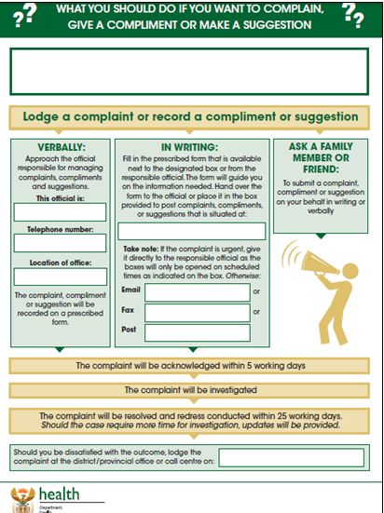
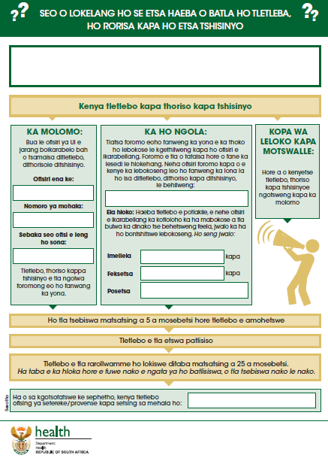
Steps 1 – Enabling complaints
Translated in 11 official languages
Posters and forms available for download form:
www.idealclinic.org.za

Slide 20
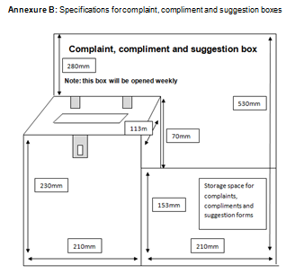
Steps 1 – Enabling complaints
Example of a box
Open boxes daily
If not feasible, place notice next to or onto box stating times when the boxes are emptied e.g every Friday
Should be opened at least once a week
Record date which box was opened as the date the complaint was received
Province/district/health facility to determine who should open the boxes – stipulate in SOP

Slide 21
Steps 2 - Responding
  Acknowledgment – 5 working days (provinces can design a standard format)
  Prioritisation (Risk rating)
    high (complaints that are patient safety incidents)
    medium (all other complaints)
  Investigation
  Redress
  define in terms of reference of committees who should conduct redress
  provide complainant with a written letter/report (not full investigation report). Province can include the format in their protocol/SOP

Slide 22
Steps 2 (cont) - Responding
  Time frame for resolving – 25 working days
  Types of closure:
  Complainant satisfied/Redress conducted
  Litigation
  Patient Safety Incident (PSI) - refer to PSI management system. Note down unique reference number of the PSI in the complaints register.
  Complainant could not be traced – must make 3 attempts to trace complainant in 2 consecutive weeks. Record dates and methods used in complaints register. Also applicable for anonymous complaints where additional information is required to enable investigation.
  Complaints register (annexure D)

Slide 23
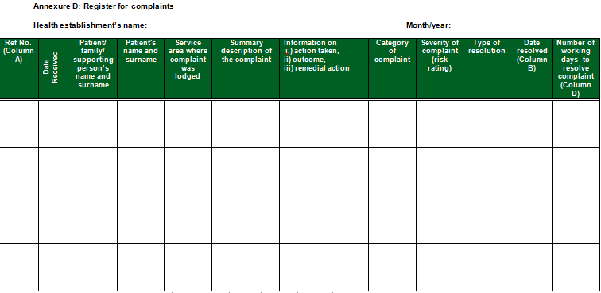
Steps 2 - Responding

Slide 24
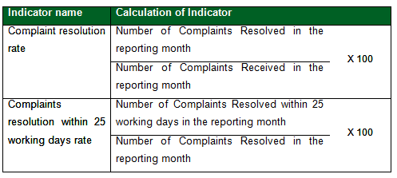
Step 3 – Accountability and learning
Reporting on complaints:
Indicators for complaints
number of complaints received per category

Slide 25
Step 3 - Accountability and learning
Categories
1. Staff attitude
2. Access to information
3. Physical access
4. Waiting times
5. Waiting list
6. Patient Care
7. Availability of medicines
8. Safe and secure environment
9. Hygiene and cleanliness
10. Other
Can choose multiple categories for a single complaint
Identify system failures: number of complaints received per category

Slide 26
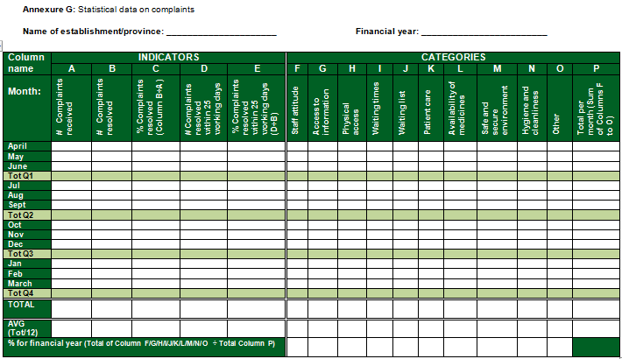
Step 3 – Reporting template

Slide 27
Compliment and suggestion management
Describes the processes to manage compliments and suggestions which include the following:
Recording a compliment or suggestion
Identifying good practises and system failures (Categorisation)
Record compliment and suggestion in a register
Reporting on compliments and suggestions

Slide 28
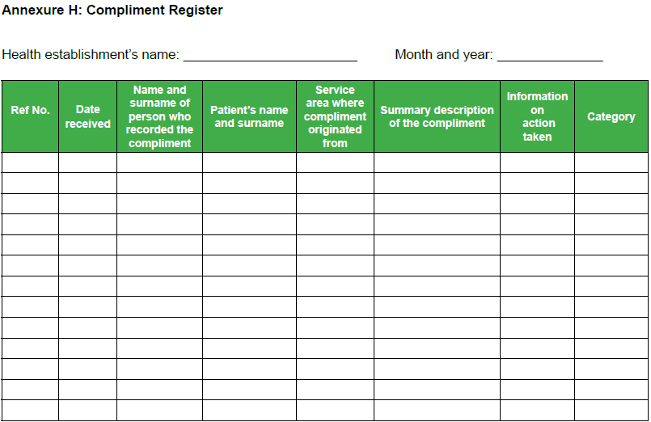
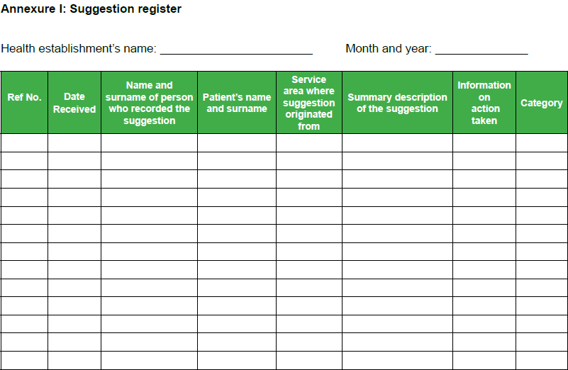
Compliment and Suggestion Registers

Slide 29
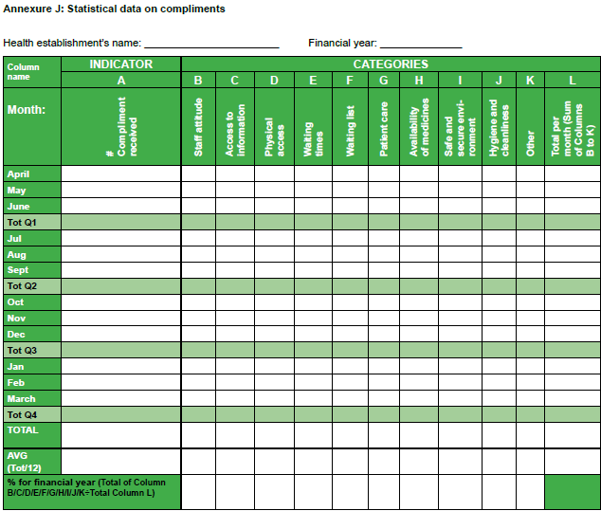
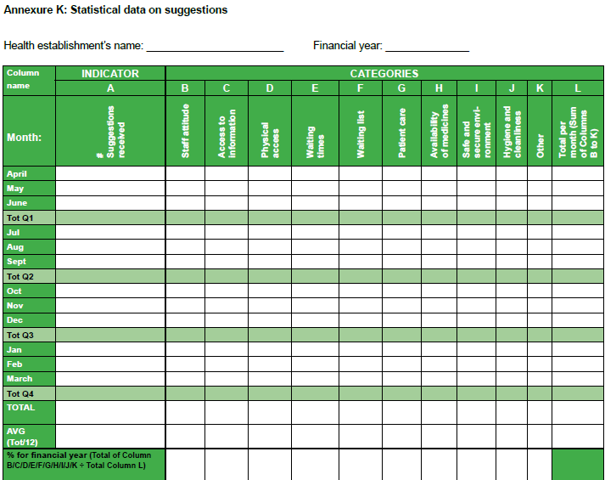
Compliment and Suggestion Reporting templates

Slide 30
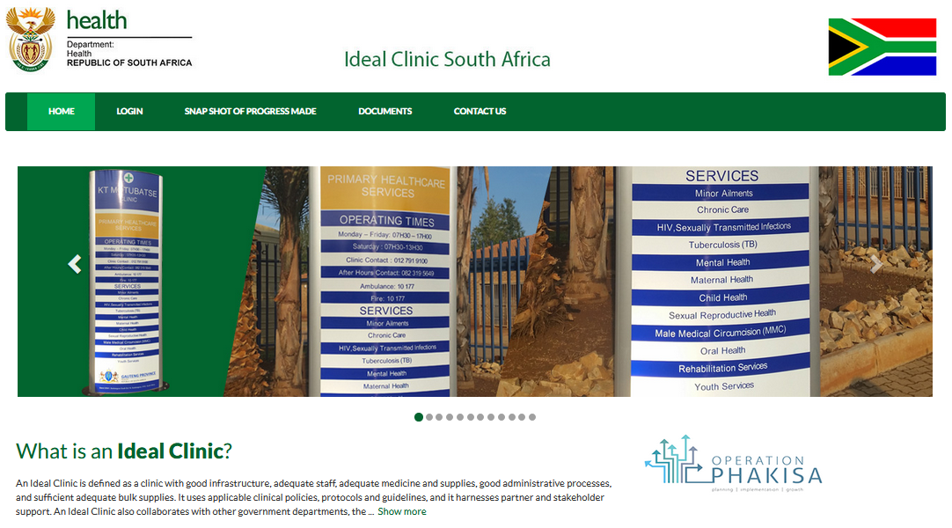
Web-based information system
https://www.idealclinic.org.za
The information system contains the prescribed form to collect data and generate reports according to the prescribed reporting format.
Helpdesk at idealclinic@health.gov.za
Access through
a user account

Slide 31
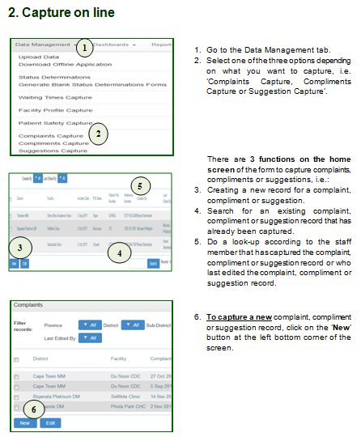
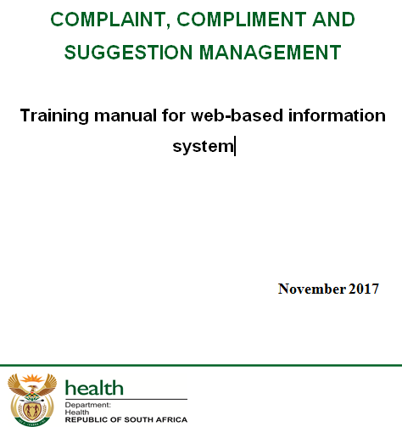
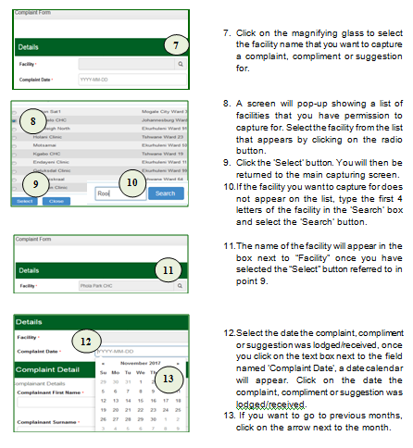
Training manual for web-based information system

Slide 32
Management of information system
Include management of web-based information system in provincial protocol/guideline/SOP
Who will have capturing rights for which levels
Who will capture complaints, compliments and suggestions that are reported at provincial/district level – be careful of duplication!
Who will be responsible for requesting user accounts
Can include responsibilities in terms of reference of committees at different levels
Indicator data on web-based information system, must be the same as the indicator data captured on DHID
Once all facilities are using the information system - will link with DHIS to automatically transfer indicator data to DHIS

Slide 33
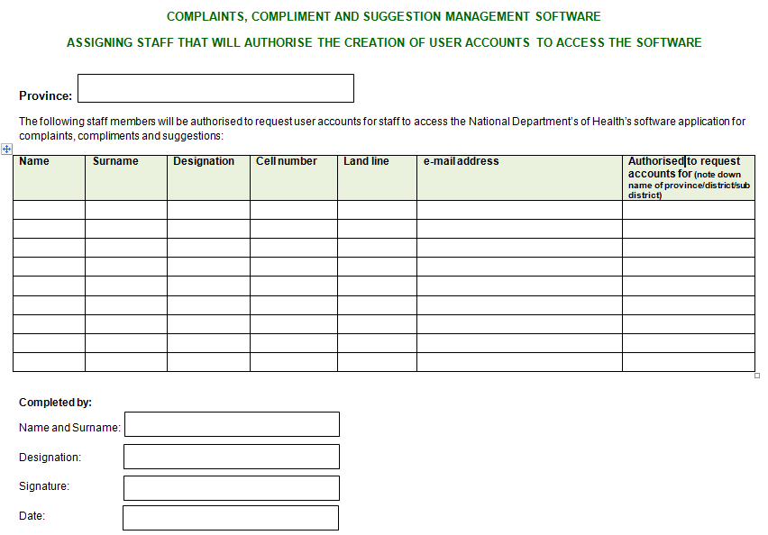
Access to Web-based information system
Every province to complete and submit a form to indicate which staff members my request user accounts from NDoH
Note: submit signed copy to ronel.steinhobel@health.gov.za

Slide 34
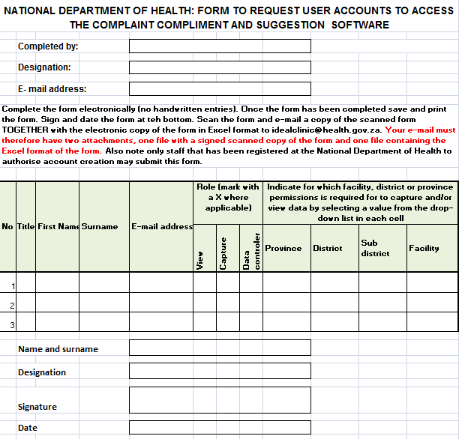
Access to Web-based information system
Only designated staff may submit the form to request user accounts to NDoH
Note: submit both scanned signed copy AND original Excel document

Slide 35
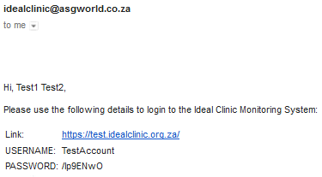
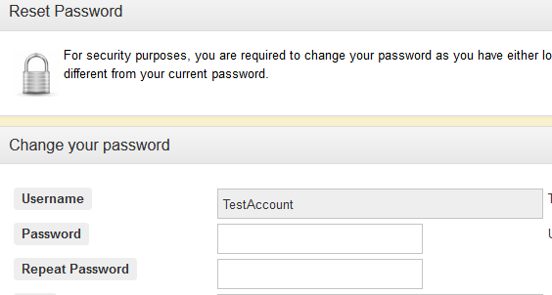
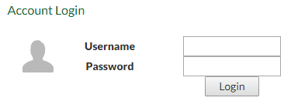
Web-based information system
Staff will receive an e-mail with login details on creation of their account
Test site: https://test.idealclinic.org.za
Username: TestAccount
Password: Password789
Enter your own password twice when logging on for the first time

Slide 36
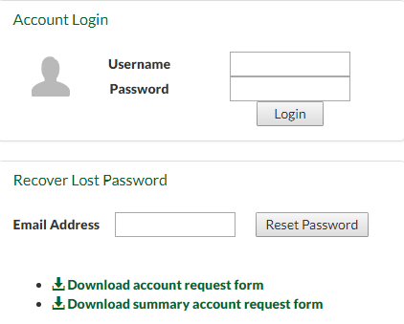

Web-based information system
What if I forgot my password?
Enter your e-mail address in the box provided, select ‘Reset Password’. An e-mail with a new temporary password will be sent.
Can also use it to verify if an account exist. If there is not an account for the e-mail address message will display

Slide 37
Monitoring and evaluation
Implemented over a 5 year period
Provinces to submit data on prescribed templates from 1 April 2018 on:
Indicators for complaints
Number of complaints received per category
Number of compliments received
Number of compliments received per category
Number of suggestions received
Number of suggestions received per category
NDoH to monitor data submitted and compile annual report

Slide 38
Monitoring and evaluation
NDoH will host in November of every year a National Quality Assurance Meeting that will be used for:
sharing provincial experiences
determining the efficacy of the Guideline
evaluating the overall national performance
Mid term review of Guideline in 30 months
Final review of Guideline in 5 years

Slide 39

END
www.health.gov.za

