Slide 1



KWAZULU NATAL
FIVE YEAR ICRM PROGRESS REPORT
Presenter: Mrs Hlobisile Langa
NDoH ICRM & QUALITY WORKSHOP
Garden Court- O.R. Tambo Airport
26 February 2020

Slide 2
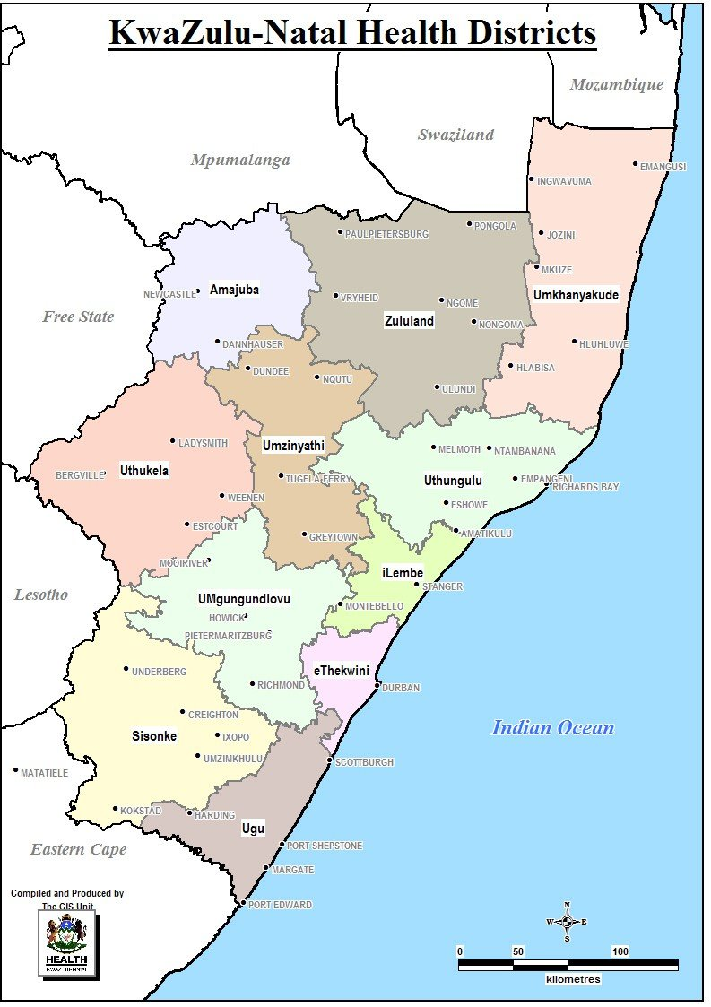
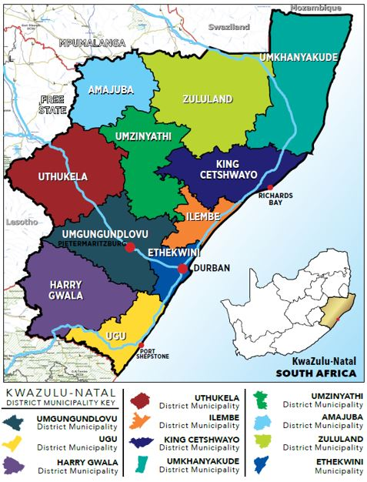
KZN Profile

Slide 3
KwaZulu Natal Profile
KwaZulu-Natal is the second most populated province in South Africa with an estimated population of 11.3 million people
The eThekwini Metro is the most populous with 33.5% of the total KZN population.
UMgungundlovu and King Cetshwayo districts are considered the economic hubs in the Province.
The population is expansive and young, with 54.89% under the age of 25 years, and almost 90% under the age of 55 years.
The life expectancy is 61.5 for males and 67.7 for females for 2019
I

Slide 4
Progress from 2015/16 t0 2018/19
Province | Total # of fixed PHC facilities | # ICs in 2015/16 | # ICs of 2015/16 that remained Ideal in 2017/18 | % ICs of 2015/16 that remained Ideal in 2017/18 | # ICs in 2016/17 | # ICs in 2016/17 that remained Ideal in 2017/18 | % ICs of 2016/17 that remained Ideal in 2017/18 | # ICs in 2017/18 | Total # ICs | Total % ICs for 2017/18 financial year | ICs in 2018/19( PR) | %ICs in 2018/19(PR) | Total # ICs 2018/19 | % ICs 2018/19
KwaZulu-Natal | 605 | 141 | 127 | 90% | 193 | 176 | 91% | 80 | 383 | 64% | 77 | 91% | 560 | 92.6%
I

Slide 5
Progress from 2015/16 t0 2019/20
Peer Review Status in 2019/20
District | # of Facilities | # Facilities that conducted SD | AVG % scored | # of Facilities with an AVG score of ≥80% | # Facilities with IC status | # of Facilities with Silver status | # of Facilities with Gold status | # of Facilities with Platinum status
KwaZulu-Natal | 605 | 46 | 71% | 10 | 19 | 11 | 7 | 1
I

Slide 6
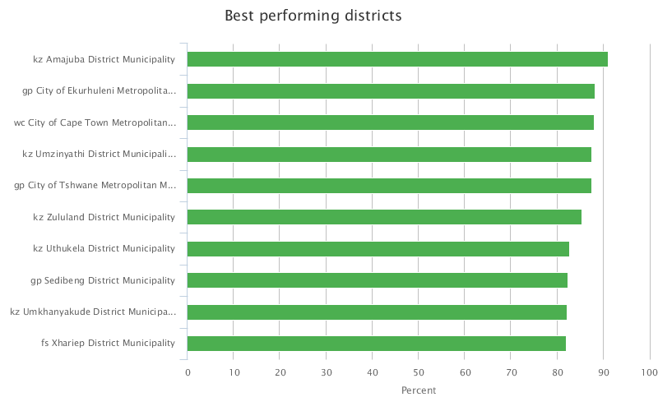
National ICRM Status as at 2019/20
I

Slide 7
Critical success factors
Establishment and appointment of the District PPTICRM Team with the Terms of reference
PPTICRM led by DCS –PHC Nurse, who were appointed as the District ICRM champion
Appointment of ICRM Champions in all facilities
Each component allocated to individuals and teams
Creation of Ideal clinic files in PHC facilities
Road Shows conducted by District PPTTICRM led by the ICRM champions in all sub districts
Adopt a clinic concept

Slide 8
Critical success factors
Mentorship by District and Sub district PPTICRM including program managers
Infrastructure and Maintenance Teams established to prioritise and ensure implementation of projects
Health Patient Registration System (HPRS) that is functional
Districts adopted a strategy to compare facility performance on monthly basis
A standing agenda item in all meetings at all levels (Facility, sub-district, DHMTs)
Capacity building of the Facility Teams especially the OMN for accountability and ownership of the programme

Slide 9
Critical success factors
Capacity building to the OMNs on Leadership and management with a measure on performance being the ICRM achievement. (Khanyanjalo Consulting)
Weekly monitoring of sub - district SCM Procurement of equipment processes
Established committees for the development of Standard Operating Procedures. (SOPs)
PPTICRM Teams visiting and supporting facilities monthly, using an integrated Supervision tool
Good buy-in and support by the District Directors

Slide 10
Establishment and continuous functionality of PPTICRM
Appointment of PPTICRM with clear TORs
Adopting facilities by PPTICRM members for support-promoting continuity of assessment.
Hold District Service Excellent award since 2016
Recognise and award quality at all levels, including Provincial level (MASEA)

Slide 11
Establishment and continuous functionality of PPTICRM
Peer assessments conducted by OMNs across the sub- districts
ICRM progress reports, weekly, monthly and quarterly
Provision of user credentials to access Ideal clinic website for duplication of statuses.
PPTICRM meetings held on monthly basis at the District level and performance of ICRM reviewed.

Slide 12
Challenges and strategies to address the challenges
Challenges | Strategy
Infrastructure Waste storage areas not complaint with ideal clinic requirements Some clinics are within the municipal structures where no alterations are acceptable | Update the 5yr maintenance plan to accommodate maintenance needs. Continuous engagement with municipalities to support with improvision to meet Ideal clinic status
Maintenance issues | Support by mother institutions on maintenance issues Establish maintenance hubs for all districts
Record management Limited space to accommodate high density filing cabinets in some facilities | Identify a suitable space within the facility for installation of high density filing Improve archiving and disposal of patient records

Slide 13
Challenges and strategies to address the challenges
Challenges | Strategy
Human Resources High staff turnover, especially of OMNs Training of PNs on BLS Appointment of staff according to WISN | Facilitate institutionalisation of Ideal clinic. Orientation of all staff members- for continuity RTC Manager to facilitate training of district master trainers Support by OES in the Provincial office
Programmatic issues Different tools and standards for ideal clinic and Regulated Norms and Standards Project managing of ideal clinic | Develop one standardised tool Institutionalise ideal clinic
Finance and SCM processes Delay in SCM processes | Appoint SCM managers as PPTICRM members
Systems and Processes Unavailability of National guidelines | Continually engage NDoH about the unavailability of policy guidelines

Slide 14
Sustainability of the programme
Establishment of ICRM teams at facility, sub district and district levels
Integrate ICRM teams with Facility Implementing Teams (FITs)
Ideal clinic tools incorporated into the PHC Supervision tool
Sub district peer reviews conducted quarterly
Set same standards for ICRM and Quality (Regulated Norms and Standards)

Slide 15
Sustainability of the programme
All Quality meetings should include ICRM as an agenda item
ICRM discussed in all forums/fora.
Institutionalise Ideal clinic- should not be treated like a project with a start and end date.
Sustainability plan- should be implemented and monitored at all levels
Progress reports on Ideal clinics, weekly, monthly and quarterly

Slide 16
Facilities that never turned ideal since but have improved scores
District | Number of facilities that have improve ICRM status
Amajuba | 0
EThekwini | 7
Harry Gwala | 4
ILembe | 2
King Cetshwayo | 7
uGu | 4
uMgungundlovu | 0
uMkhanyakude | 5
uMzinyathi | 0
UThukela | 2
Zululand | 4
Total | 35

Slide 17
Factors leading to facilities dropping their status
Lack of onsite supervision by OMNs
High attrition rate
Delayed SCM processes
Lack of support by supporting institutions (mother facilities)
Treating ideal clinic as a project
Non involvement of some PHC Managers in ICRM processes
Sub -standard quality of equipment
Aging infrastructure in some facilities
National supplier problems with medicine stock outs

Slide 18
Role of Clinic supervisors, PHC Managers/ Area managers
Advocate and lobby for resources
Intensify support supervision
Conduct ongoing performance reviews
Provide oversight on the implementation of QIPs
Facilitate orientation on latest versions of ideal clinic
Co-ordinate workshops, namely ICSM, BANC plus and other

Slide 19
Key Lessons learnt
Team work
Integration of PPTICRM with allied workers (therapists and pharmacists)
Benchmarking from peers
Commitment by all relevant stakeholders
Accountability
Support and continuous supervision

Slide 20
Critical Role Players for the success of the Ideal Clinic
CEOs and executives in the supporting/ mother facilities should embrace ideal clinic [ Systems manager- Maintenance officers, Finance manager, SCM, HR manager, M&E management]
Sub district managers/ PHC Co-ordinators/ Managers and Development and Training managers and all DCST members
All programme managers in the district offices
Governance structures
Provincial managers- including IT and infrastructure, Budget office
Other government departments, including Department of Transport (for road signages) and Local municipalities

Slide 21
Ensuring the objectivity in conducting Baseline SD, PR and PRUs
Adhering to the guidelines and steps in the Ideal clinic manual
Using the correct version- manual and checklists
SD- FM should be conducted by sub-district peers within the sub districts.
Pre- audit meetings to agree on standards
PRU should be conducted by the sub- district PPTICRM [led by the PHC Managers]
N.B. The processes should be aimed at provision of quality services rather than achieving high scores

Slide 22
Relationship between the Ideal Clinic and OHSC
Ideal clinic and OHSC are quality oriented
Ideal clinic is a stepping stone for achieving accreditation by OHSC
Announced visits by the OHSC should be in line with ideal clinic assessment period

Slide 23
Relation between the Ideal Clinic and NHI?
Ideal clinic is a building block for NHI implementation
PHC facilities will be contracted to provide services and therefore ideal clinic prepares them such that they will be ready for this activity
PHC facilities will be assessed and accredited to be NHI compliant

Slide 24
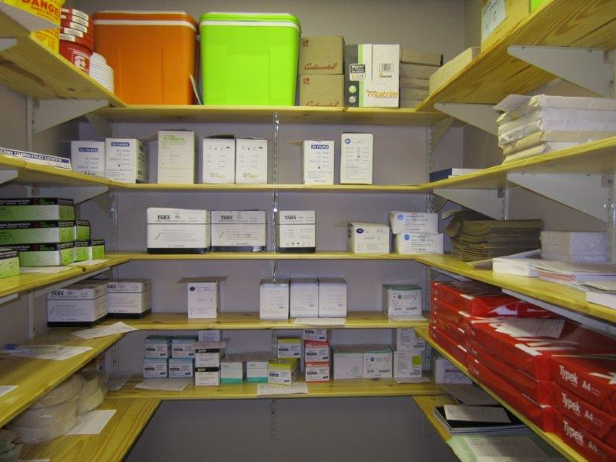

Slide 25
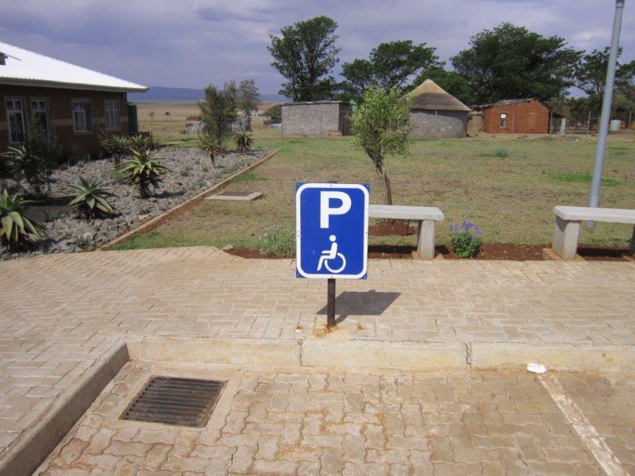

Slide 26
Acknowledgements
Mr K. Mahlako – NDoH: Director- PHC
Mr J. Mndebele – KZN DOH Chief Director- DHS
Mrs N. S. Radebe - Former KZN Provincial Director PHC and ICRM Champion
All District Directors
District ICRM Champions
District PPTICRMs
Sub- District CEOs and executive committees
PHC Managers
All Operational Managers
Facility ICRM teams

Slide 27

Thank you
Thank you

