Slide 1

^{when the sun rises}
^{we work hard to deliver}
MPUMALANGA DEPARTMENT OF HEALTH
PROGRESS REPORT ON THE IMPLEMENTATION OF IDEAL CLINIC INITIATIVE
FEBRUARY 2020

Slide 2
PRESENTATION OUTLINE
1. Background
2. Progress from 2015 to date
3. Critical success factors
4. Establishment and continuous functionality of PPTICRM- Keeping ICRM teams
motivated
5. Identified challenges and reasons for non-achievement
6. Strategies to address identified challenges
7. Sustainability of the programme
8. Key issues highlighted
9. Ideal clinic rate- MTSF target

Slide 3
1.BACKGROUND
  The Ideal Clinic initiative has been implemented in Mpumalanga since 2015 following the operation Phakisa laboratory sitting and subsequent launch by the President on the 18 November 2014
  The ICRM Programme was received with much enthusiasm, Political will, buy in from Managers at all levels, PPTICRM teams were established etc
  ICRM Implementation plan was developed taking into cognisance the 8 Streams ( Waiting Time, Infrastructure, HRH, Service delivery, Financial Mx, Supply Chain, Sustainability, Institutional Arrangements)
  The progress made to date is highlighted in the slides to follow

Slide 4
2. PROGRESS FROM 2015 TO DATE
Province | Total # of facilities | Ideal by 2015/16 | # Facilities that remained Ideal in 2017/18 from 2015/16 and 2016/17 financial year | # Facilities with IC status in 2017/18 (PR and PRU SDs only) | Total # of Ideal Facilities in 2017/18 | Total # of Ideal Facilities in 2018/19 | % of Ideal facilities in 2018/19
Mpumalanga | 287 | 19 | 46 | 41 | 87 | 133 | 46.34%
Ehlanzeni | 121 | 4 | 2 | 8 | 10 | 26 | 21.5%
Gert Sibande | 76 | 11 | 37 | 18 | 55 | 69 | 90.8%
Nkangala | 90 | 4 | 7 | 15 | 22 | 38 | 42.2%

Slide 5
2.PROGRESS FROM 2015 TO DATE CONT…
Status determination conducted by the District PPTICRM in all 287 PHC facilities, to establish a baseline.
The newly targeted PHC facilities for 2019/20 scale up plan is 56 (23 Nkangala and 33 in Ehlanzeni. These are PHC facilities that were never subjected to scale up plan.
Gert Sibande has already subjected all 76 PHC facilities to the scale up plan and the District PPTICRM will conduct the assessments based on the continuous update done by the PHC facilities.
Cross district peer review assessments conducted with the support of the NDoH between 11-22 November 2019, and the participating districts were Ehlanzeni and Nkangala.
Peer review updates will then be conducted by the relevant district PPTICRMs in the 4th quarter to those PHC facilities that have failed, and requiring minor issues to be addressed.

Slide 6
3. CRITICAL SUCCESS FACTORS
All 76 PHC facilities in Gert Sibande have been subjected to scale up plan and 69 obtained the ideal clinic status.
4 Facilities have been put on the Scale up plan : Lothair CHC , Ermelo town Clinic , MN Cindi Clinic and Badplaas CHC and the scores are improving.
Infrastructure
Budget is allocated for infrastructure upgrade and maintenance, though very limited as it cannot cover all identified health facilities.
Support from implementing partners.
Commitment from all staff members in reporting and addressing maintenance challenges.
Support from the provincial infrastructure unit, districts and sub-districts.
The following facilities were under renovations in Gert Sibande (MN Cindi , Ermelo town clinic- scores improving), (Volksrust clinic , Perdekop CHC and Wakkerstroom clinic – attained and sustained the Ideal clinic status.

Slide 7
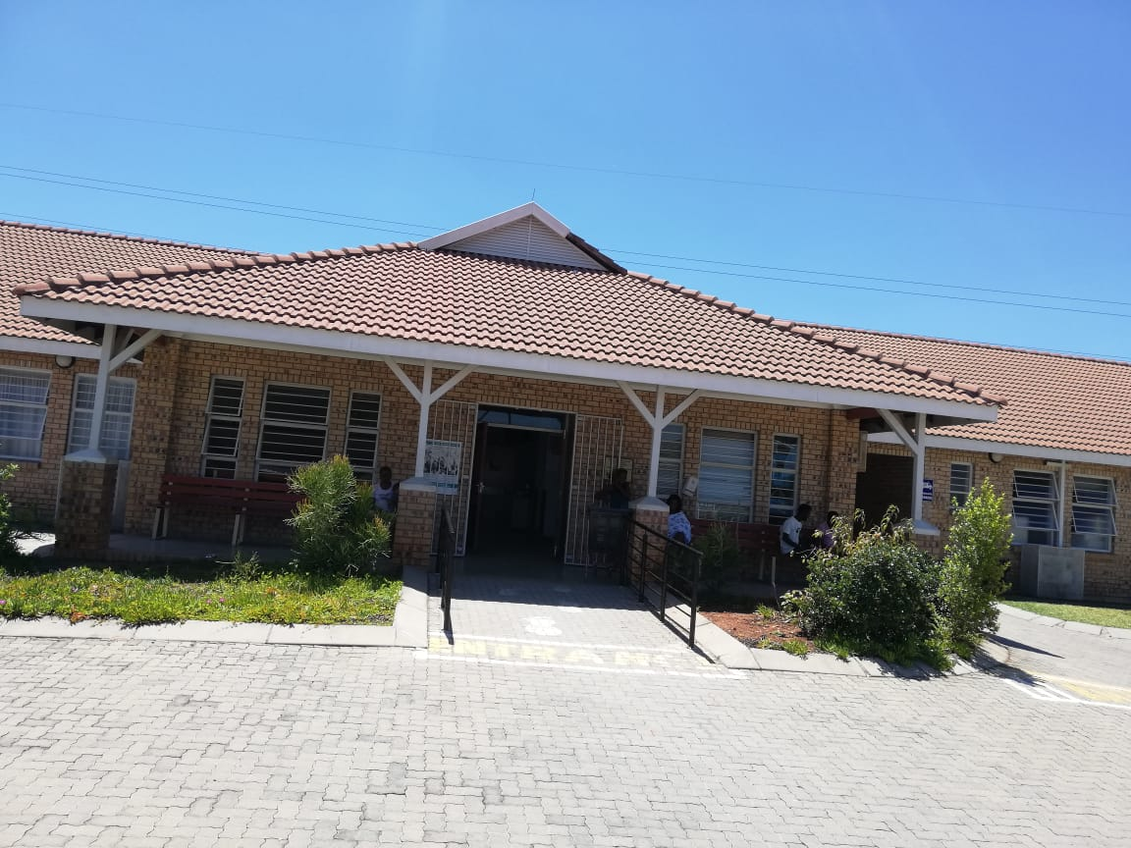
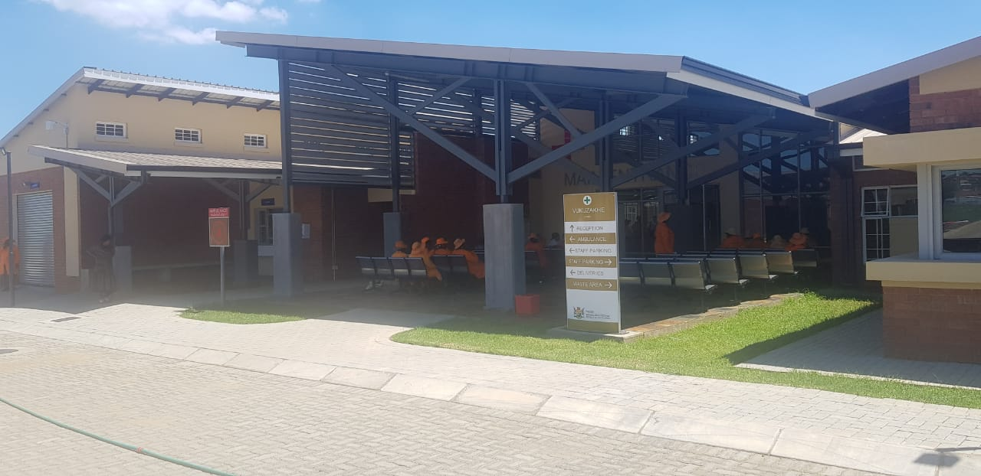
3. CRITICAL SUCCESS FACTORS: INFRASTRUCTURE

Slide 8
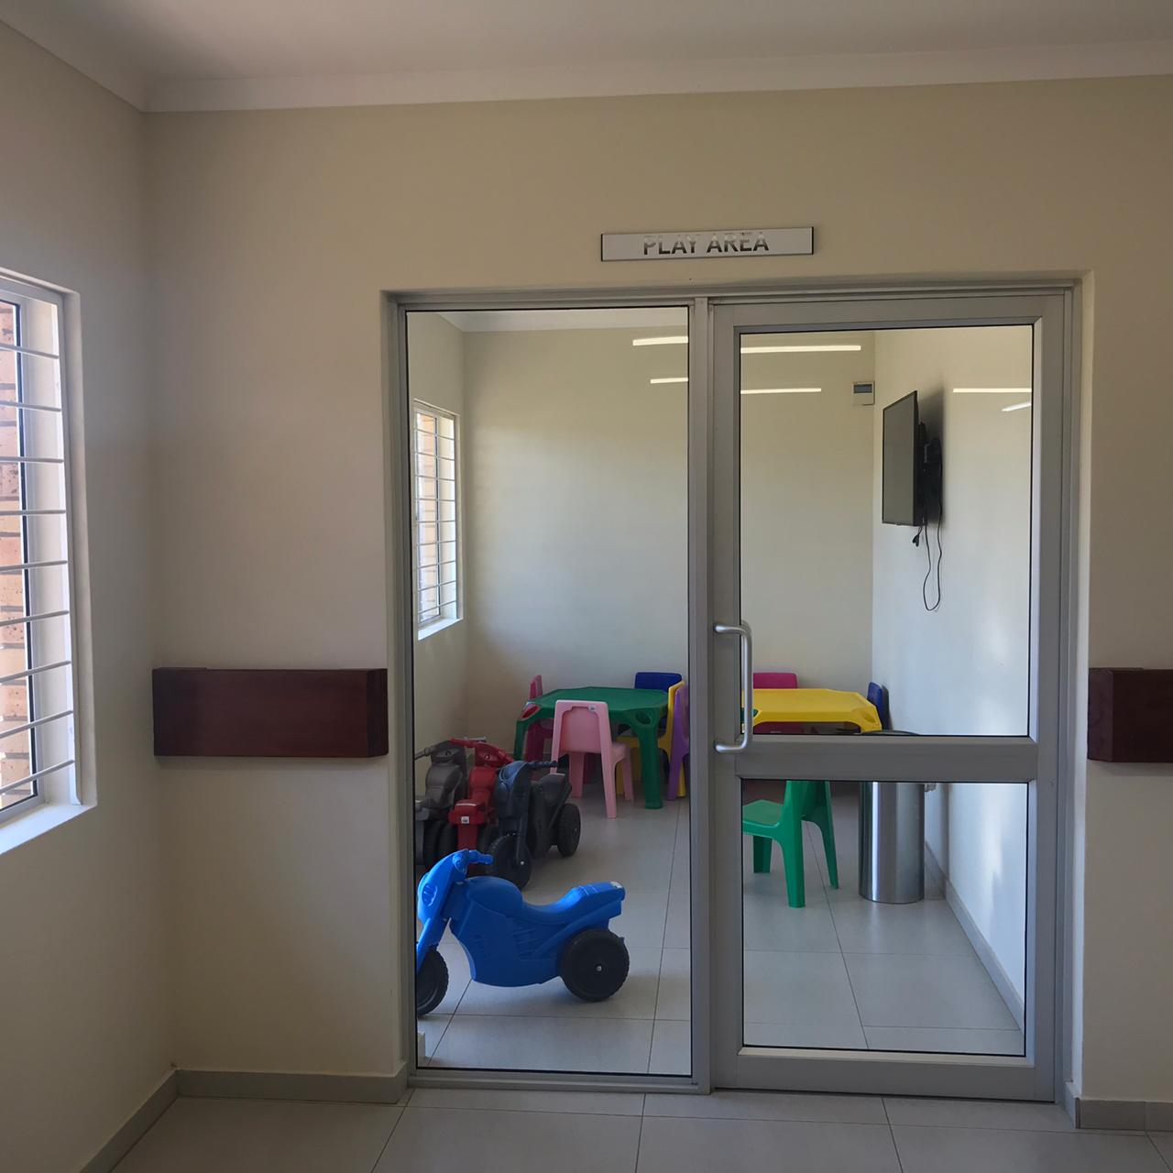
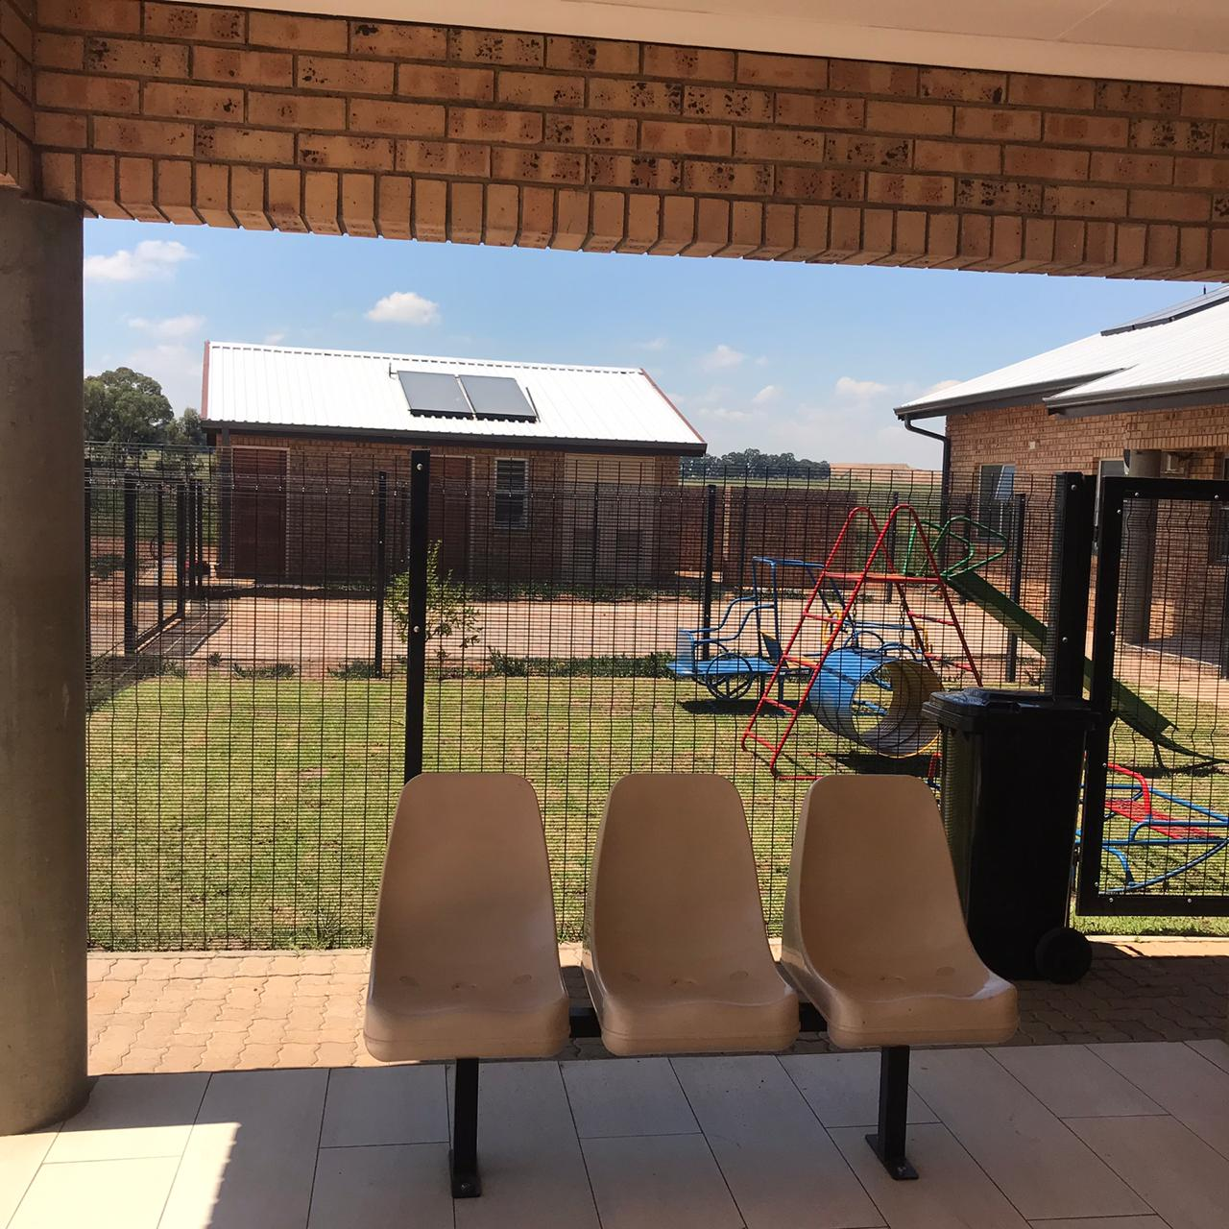
3. CRITICAL SUCCESS FACTORS: INFRASTRUCTURE

Slide 9
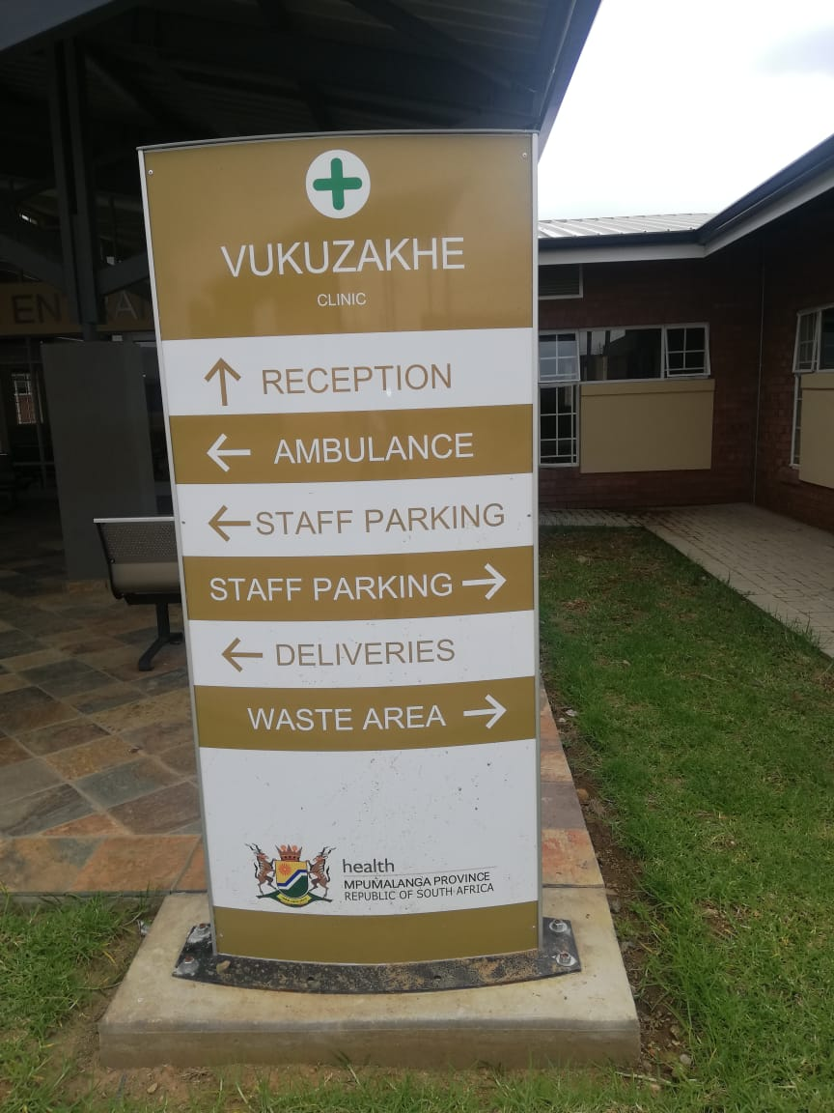
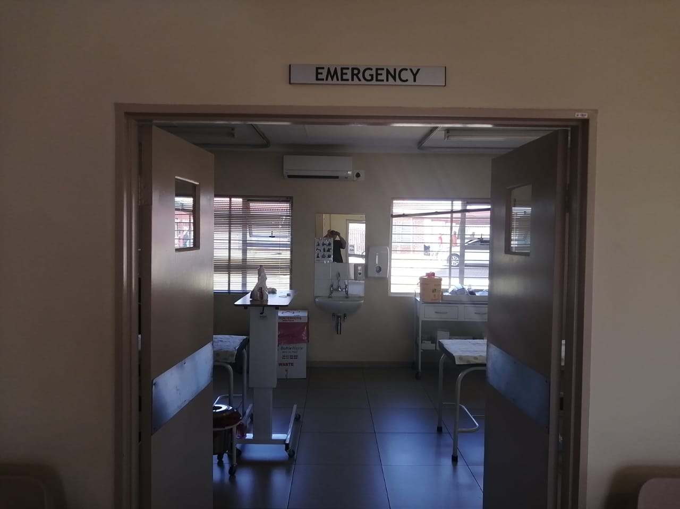
3. CRITICAL SUCCESS FACTORS: SIGNAGE

Slide 10
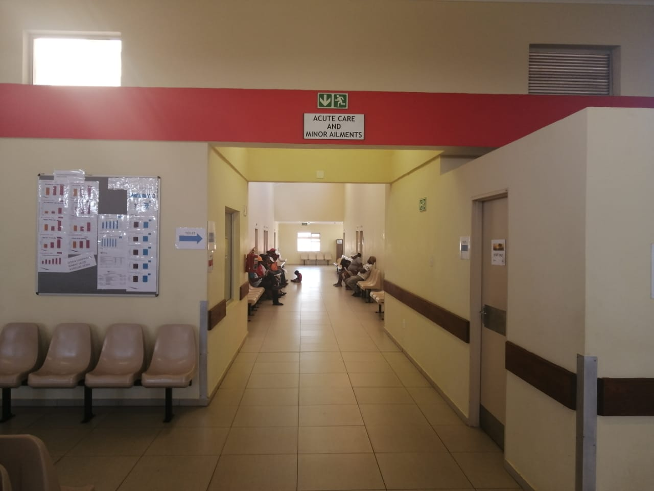
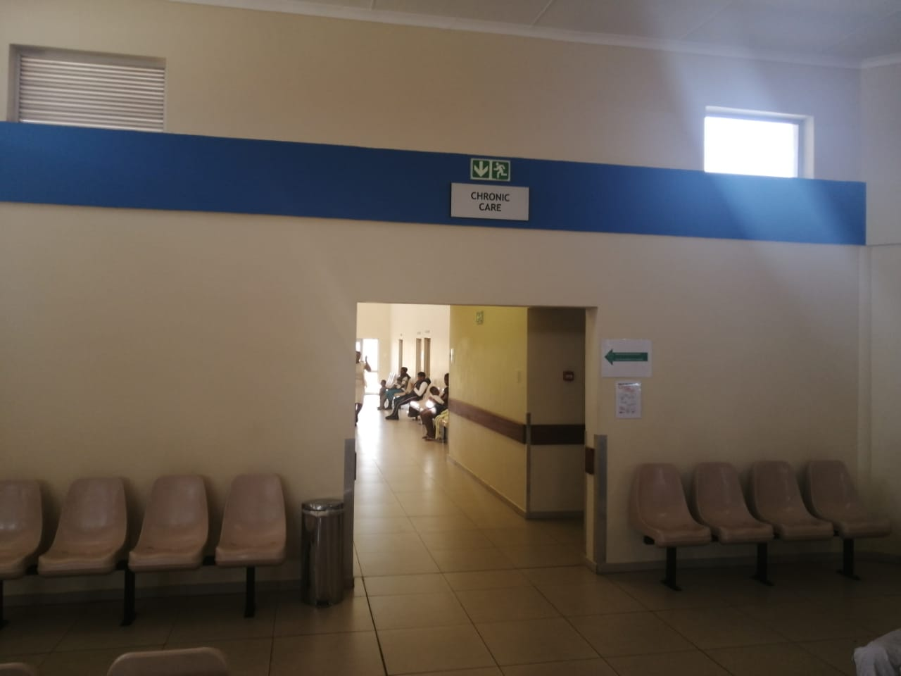
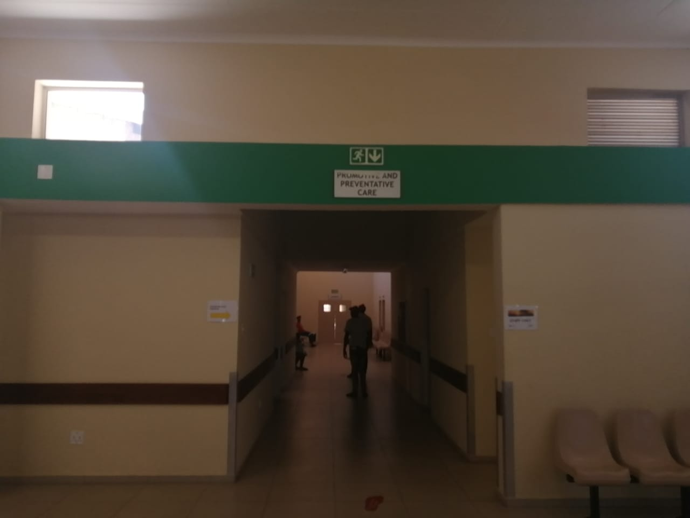
3. CRITICAL SUCCESS FACTORS : ICSM

Slide 11
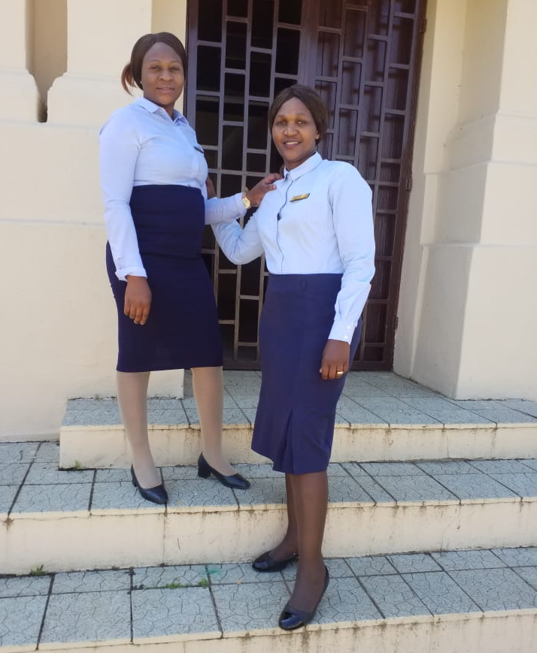
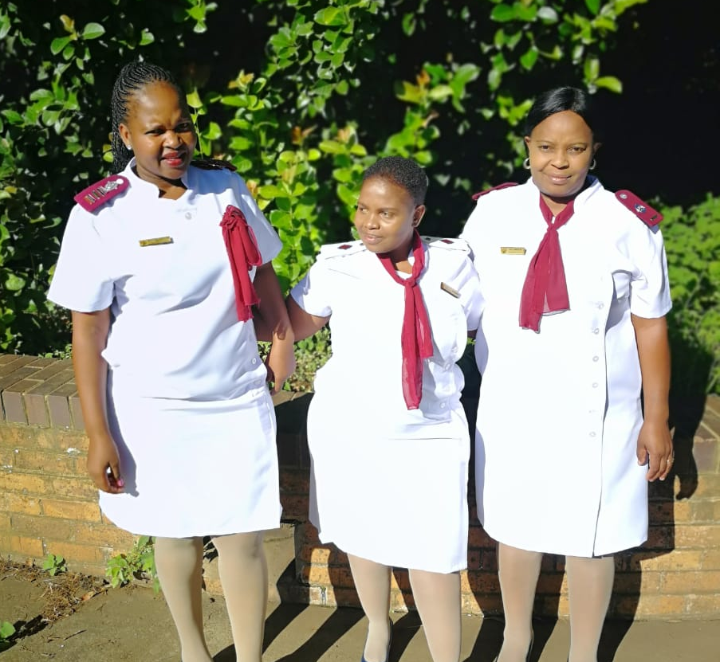
3. CRITICAL SUCCESS FACTORS: DRESS CODE
Admin Clerks / Data Capturers
Professional Nurses

Slide 12
3. CRITICAL SUCCESS FACTORS CONT…
Equipment
Budget is allocated for ICRM, though it is inadequate
Medical equipment is prioritized for targeted PHC facilities.
Support from implementing partners.
Commitment from all staff members in asset management.
Procurement of equipment is done by the districts with the support of provincial PHC and Health Technology unit.

Slide 13
3. CRITICAL SUCCESS FACTORS CONT..
The following trainings were conducted among other, in 2019/20:
Integrated clinical services management (ICSM) with the support of NDOH- in the three districts.
Patient-centric culture conducted with the support of NDOH, to Operational Managers for targeted PHC facilities, two trainers for Ehlanzeni and two trainers for Nkangala district in September 2019.
Basic life support (BLS) was ongoing, however due to resources constraints and the re-allocation of the trainer to a hospital, the training got interrupted.
Training of OPMs and supervisors including Health Information Officers conducted on an annual basis.
Training on HPRS

Slide 14
3. CRITICAL SUCCESS FACTORS CONT..
Buy- in and ownership by staff
Facility Support from the PPTICRM
Continuous rendering of quality services by personnel at PHC facilities
Support from the Clinic Committees
Pockets of good leadership and governance
Competent operational managers

Slide 15
4. ESTABLISHMENT AND CONTINUOUS FUNCTIONALITY OF PPTICRM
- KEEPING ICRM TEAMS MOTIVATED
Strengthen functionality of established Provincial and district PPTICRMs.
Continuous support of PHC facilities by Districts and Provincial management.
Involvement of PHC managers ,PHC supervisors and OPMs as team members.
Conducting sub-district peer reviews.
ICRM being a standing agenda item in the district and sub-district PHC meetings.
Need for continuous monitoring of the ideal clinic quality Improvement plans and reinforcement of compliance to promote change.
Acknowledgement of good performance

Slide 16
5 & 6 CHALLENGES AND STRATEGIES TO ADDRESS CHALLENGES
5 .Identified challenges and reasons for non-achievement | 6 .Strategies to address identified challenges
Inadequate functionality of PPTICRMs | -Revival of established PPTICRMs at all levels by meeting quarterly. -Monitor functionality of PPTICRM at all levels
Inadequate management of PHC facilities, some PHC facilities have acting OPMs. | -Prioritize appointment of OPMs for identified PHC facilities. -Provide support and monitor performance of OPMs.
Shortage of staff, mostly lower category of staff, like, Enrolled Nurses, Enrolled Nursing Assistants, Data capturers, pharmacists Assistants, Grounds men and Cleaners. | Implementing WISN/ organizational structure by prioritizing filling of critical vacant posts.
High staff turn over | -Constant recognition of excellence and provision for team building sessions -Prompt filing of vacant posts

Slide 17
5 &6 CHALLENGES AND STRATEGIES TO ADDRESS CHALLENGES CONT..
5. Identified challenges and reasons for non-achievement | 6 .Strategies to address identified challenges
Dilapidated infrastructure | Infrastructure upgrading / renovation / construction of Infrastructure to address the needed space as per Ideal Clinic tool.
Inadequate maintenance of infrastructure and equipment | Develop and implement Maintenance Plans for infrastructure and equipment.
Poor records management. | -Continuous training of personnel on record management at all levels. -Prioritize space for filing of patient records. Implementing partner providing support with infrastructure to improve filing in Ehlanzeni.
Management of general waste- municipality lacking capacity | Municipality to provide support with management of general waste in rural areas

Slide 18
5 & 6 CHALLENGES AND STRATEGIES TO ADDRESS CHALLENGES CONT..
5 .Identified challenges and reasons for non-achievement | 6.Strategies to address identified challenges
Outdated / non availability of NDOH Policies. | NDOH to prioritize finalization of relevant policies and MOUs e.g. ( MOU with SAPS)
Inadequate transport for PHC supervision | Procurement of additional vehicles as per identifies need, e.g. for PHC supervision, mobile clinic, school health services and ward-based outreach teams.
Inadequate PHC supervision due to inadequate number of PHC supervisors | Prioritize appointment of PHC supervisors/ rationalize available staff for efficient use of available resources.
Late delivery of procured equipment/goods by suppliers. | Contract management, that is to reinforce adherence to the schedule for delivery of procured goods as stipulated in the contracts.
Inadequate budget for non-negotiables, e.g. pest control and cleaning material. | Provision of adequate Ideal Clinic grant, to cater for all the identified resources, including signage, furniture, cleaning equipment and material, etc.

Slide 19
7.SUSTAINABILITY OF THE PROGRAMME
PHC supervision according to the supervision policy and monitoring of quality improvement plans by OPMs, Supervisors and PHC Managers at all levels.
Assessment of facilities for SD by PPTICRMs at least bi-annually for monitoring and continuous improvement.
Annual training of OPMs on ICRM dashboard and checklist.
Sustained Political will and adequate provision for the ICRM initiative.
Compliance to ideal clinic norms and standards
Team spirit
Recognition of excellence
Enforcement of accountability at all levels

Slide 20
8.KEY ISSUES TO BE HIGHLIGHTED
  8.1. Facilities that never turned ideal since inception but have improved from their initial scores:
Ehlanzeni (5) | Gert Sibande (4) | Nkangala (26)
Zoeknog; Shatale; Maviljan; Mananga clinics and Bhuga CHC | Lothair CHC; Ermelo; MN Cindi and Badplaas CHC | Eastdene ; Pullenshope ; Sakhelwe ; Emthonjeni ; Waterval Boven Gate and Wonderfontein ; Louise Street ; Poly ; Botleng CHC; Gembokspruit; Empilweni ; Vriesgewacht ; Kameelpoortnek ; Tweefontein A; Tweefontein H Clinics; Allemansdrift CHC; Wolwekraal ; Diphalane CHC; Haakdooringlaagte ;Kalkfontein; Kameelrivier ; Lefisoane ; Pieterskraal ; Senzangakhona ; Troya and Valschfontein Clinics

Slide 21
8.KEY ISSUES TO BE HIGHLIGHTED CONT..
8.2. Factors that lead to facilities dropping their status
Inadequate maintenance of equipment and infrastructure.
Poor implementation and monitoring of quality improvement plans.
Non filling of vacant funded posts- shortage of staff.
Inadequate supervision and support due to poor leadership (acting OPMs) and inadequate number of appointed PHC supervisors.

Slide 22
8.KEY ISSUES TO BE HIGHLIGHTED CONT
  8.3.Key lessons learned:
  To obtain and sustain the ideal clinic status requires team work and commitment from all relevant stakeholders at all levels.
  Ideal clinic status is a process and not a once off event and requires consistent maintenance.
  Consistent training to improve objectivity in conducting baseline SD, PR and PRUs.
  The relationship between Ideal Clinic and promulgated norms and standards for the OHSC.
  The relationship between Ideal health facility framework and NHI.
  The critical role players for the success of Ideal Clinic, that is: The MEC, HOD, provincial PHC managers at all levels, District managers all levels, PHC supervisors, OPMs and all facility personnel at all levels.

Slide 23
8. KEY ISSUES TO BE HIGHLIGHTED CONT…
  8.4.Ensuring the objectivity in conducting Baseline SD, PR and
  PRU
  Calibration and thorough training of assessors,
  Regular reference to the Ideal Clinic manual during assessments.
  Assessors must be part of the District PPTICRM team to be familiar with the process
  Fairness, integrity is to be observed by assessors at all times.
  The Peer Review (PR) team must be balanced and include members from different districts / Provinces if possible( e.g. 1 team must have 1 representative from the other district / Province)
  Screen assessors – knowledgeable and good role models, dress code, communication skills, respect.

Slide 24
8. KEY ISSUES TO BE HIGHLIGHTED CONT…
  8.5. The relationship between the Ideal Clinic and OHSC
  Tools have been synchronized
  Integration of Quality Improvement plans
  8.6. The relation between the Ideal Clinic and NHI?
  Build up towards NHI

Slide 25
9.IDEAL CLINIC RATE- MTSF TARGET (REVISED)
District/ Metro | 2018/19 Scale Up Facilities | 2019/20 target | 2020/21 target | 2021/2022 target | 2022/23 target | 2023/24cale target
Ehlanzeni | 27.2% (15/121) | 51.2 (62/121) | 34.1% (42/123) | 50% (45/123) | 50.4% (62/123) | 77.2% (95/123)
Gert Sibande | 98.6% (71/76) | 94.7% (72/76) | 94.7% (72/76) | 97.3% (74/76) | 100% (76/76) | 100% (76/76)
Nkangala | 33.3% (30/90) | 63.3% (57/90) | 52.7% (48/91) | 60% (55/91) | 71.4% (65/91) | 100% (91/91)
Mpumalanga | 40.4% (116/287) | 66.6% (191/287) | 55.6% (162/290) | 60% 174/290) | 70% (203/290) | 90.3% (262/290)

Slide 26
Thank you

