Slide 1
IDEAL CLINIC PROGRAMME
Update on changes made to ICRM software
Problems identified with capturing of data
Ronel Steinhobel
15 September 2015

Slide 2
Contents
Different modules of the software
Data flow
Off line module
Web-based module
  How to request user accounts
  Forms to request user accounts
  User permissions
  Logging on
  Functionality of the software
  Changes in weights

Slide 3
Modules of ICRM software
Live data
To be uploaded on live data
For training
On line module
www.health.gov.za or www.idealclinic.org.za
Off line module
Download from www.ideal clinic.org.za
On a memory stick that was provided to all facilities
Test module
test.idealclinic.co.za
No user account needed
Username = test
Password = password
Request user account from NDoH
No user account needed
Admin Pin = 1234

Slide 4
Data flow
Clinic/CHC
Computer available
Yes
Develop QIP
Connectivity available
No
Yes
No
Clinic/CHC capture data on online module .... Generate Report
QIP
Clinic/CHC capture data on off- line module Generate Report QIP
Clinic/CHC complete hard copy of dashboard
Clinic/CHC export data file to a memory stick/disk. Memory stick/disk send to or collected by Sub – /District Office
Report back to Clinic/CHC
Data capturer at Sub –/District Office capture data on online survey module
Generate report
Sub -/District Office import data file on online survey module
Data available on web based software (online module)

Slide 5

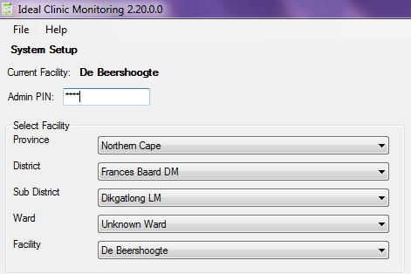
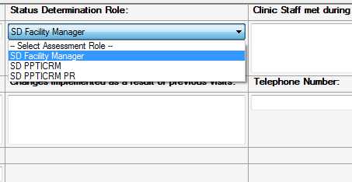
Off line module – Version 2.20
Changes
Facility data
SD roles

Slide 6
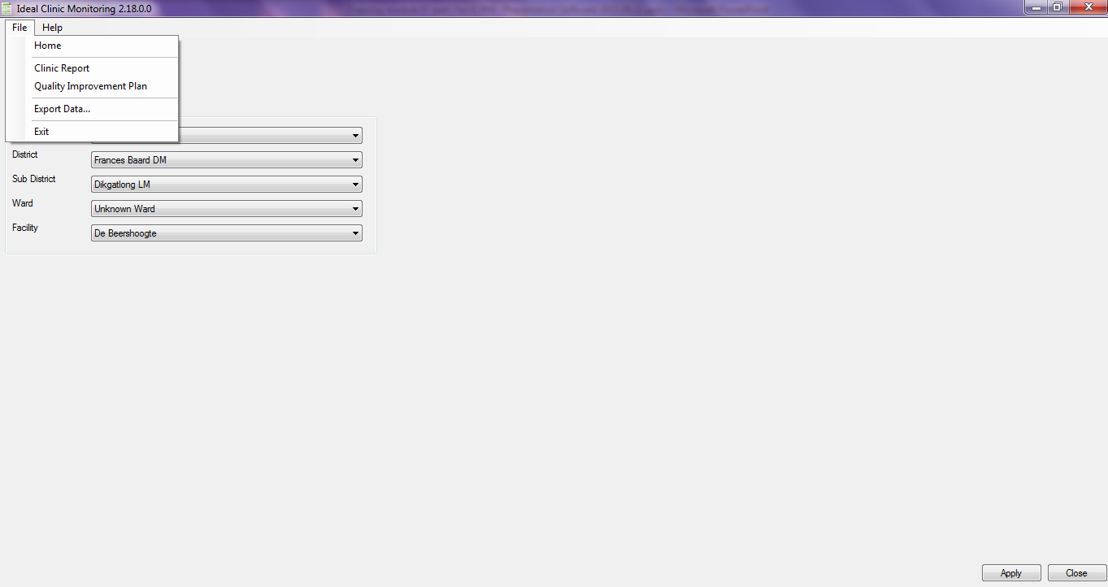
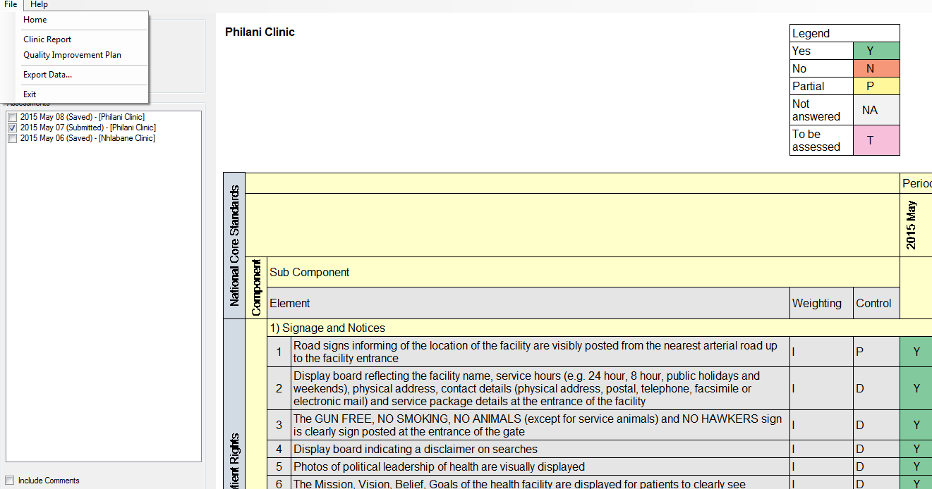
Off line module
When capturing multiple facilities on the same Off line module – make sure correct facility name is selected
Procedure to delete captured status determinations from the Offline module

Slide 7
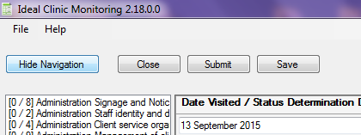
Off line module – verifying data
Data capturer capture SD
‘Save’ SD
Print SD report
Facility manager/PPTICRM verify that SD was captured correctly by signing and dating report
Give signed, dated SD report to data capturer to ‘Submit’ the data
*Status Determination (SD)

Slide 8
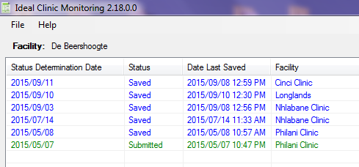
Off line module – status of SD
Before exporting data check that Status of the status
determination (SD) is reflected as “Submitted” and not
saved

Slide 9

Web-based software (1)
Access through NDoH website (www.health.gov.za)

Slide 10

Web-based software (2)
www.idealclinic.org.za
Access on tab: ‘Ideal Clinic Monitoring System’

Slide 11
How to request user accounts
Complete form to request a user account – Must be electronic
Submit to District Manager/Team leader of PPTICRM/ Provincial Office
Submit to National Department of Health
Perfect Permanent Team for Ideal Clinic
Realisation and Maintenance (PPTICRM)

Slide 12
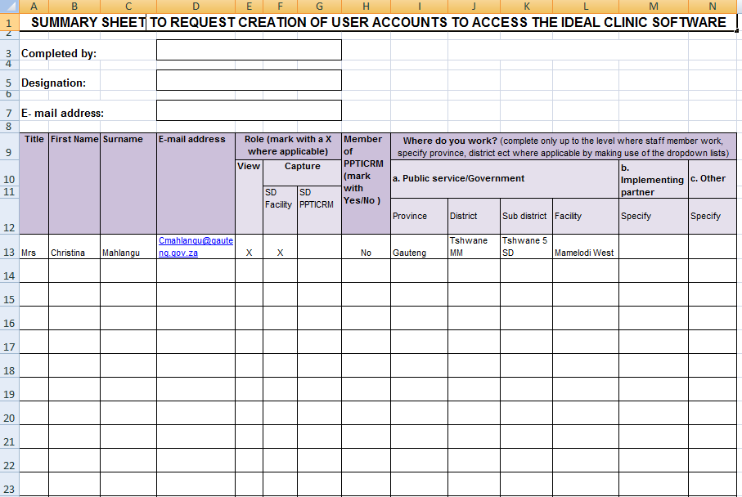
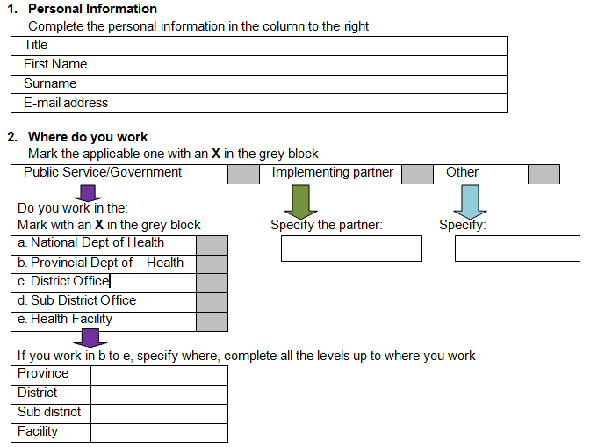
Forms to request user accounts
For multiple accounts : Excel document
For single account : Word document

Slide 13
Permissions on user accounts - roles
Two roles
Viewing
Capturing
Capture for SD conducted by Facility manager = SD Facility manager
Capture for SD conducted by District PPTICRM = SD PPTICRM
Capture for SD conducted by District PPTICRM from another province = SD PPTICRM PR
* Status Determination (SD)

Slide 14
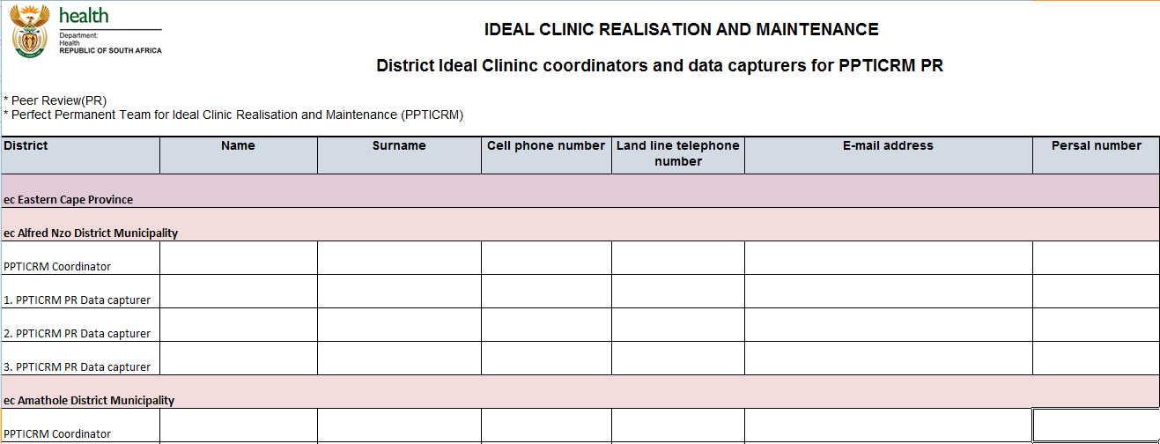
Permissions on user accounts
PPTICRM PR
E-mail form to provincial coordinators complete before
or on 16th September 2015

Slide 15
Permissions on user accounts to capture
National
Provincial
District
Sub district
Facility
Assigned according to where user work

Slide 16
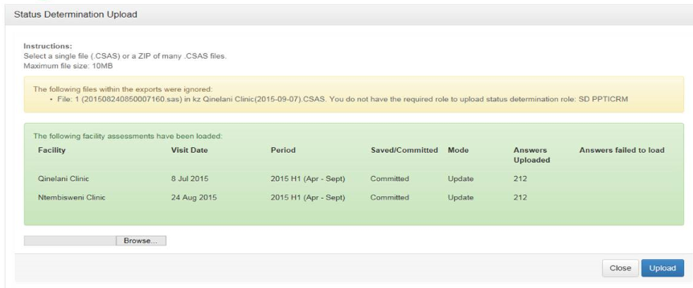
Permissions on user accounts to capture – Uploading of data from Off line module
Web based software check whether user that is uploading data
has permission to upload captured data: check the SD role as
well as facilities user have been registered to capture for

Slide 17
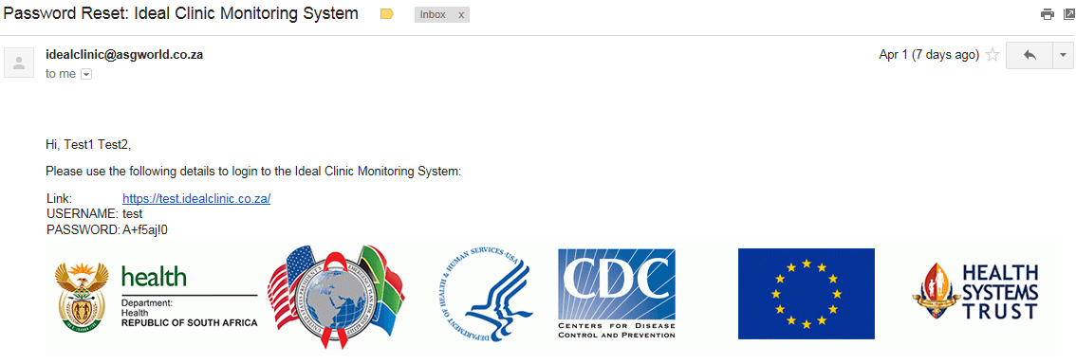
Logging on: e-mail with login details
Once the form to request a user account has been processed you will receive an e-mail with login details

Slide 18
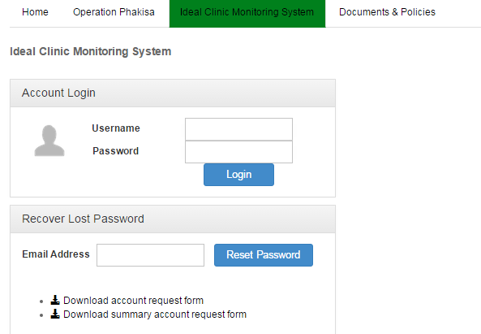


Logging on and password recovering
Account is not active/created
Check whether account is active
Account created / active

Slide 19
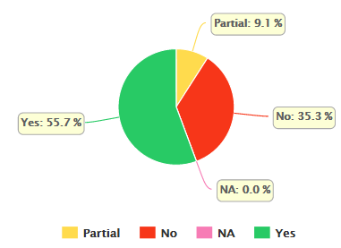
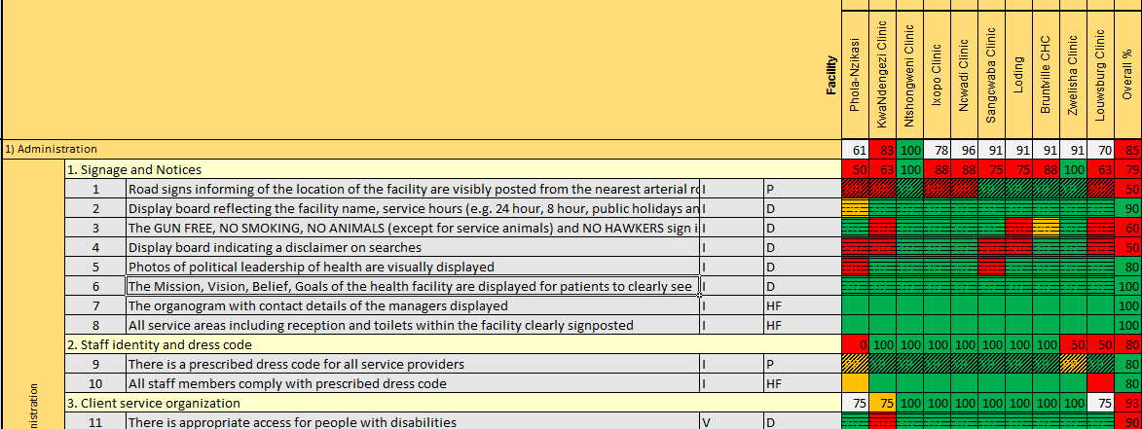
Functionality of software
Data management
    capture status determination
Dashboard
    graphic display of data
Reports
    Excel reports
Help
    video clips and document section

Slide 20
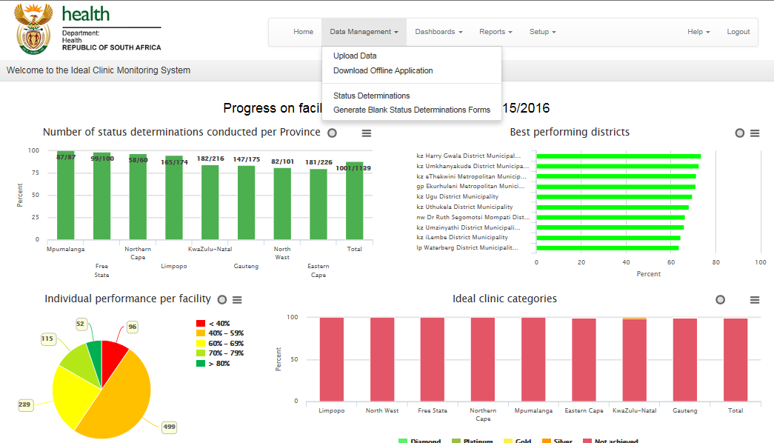
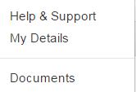
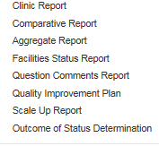
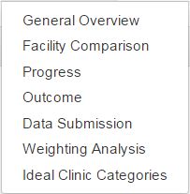
Functionality of software (2)

Slide 21
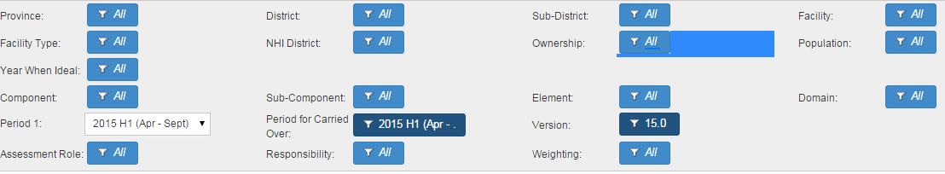
Functionality of software (3)
Filters - generation of reports at various levels
Filters
Province | Facility type | Component | Period
District | NHI district | Sub Component | Responsibility
Sub district | Ownership | Element | Weighting
Facility | Population | Domain | Status determination role
Version | Carried over | Year when Ideal

Slide 22
Changes in weights
NO | Element | Current weight | New weight
80 | There is a contingency plan to manage inappropriate room temperatures | V | I
85 | The facility has sufficient stock to dispense chronic medication for 2 months | V | E
86 | Re-ordering stock levels (min/max) is determined for each item on the Essential Medicine List | V | E
90 | Specimens are handled according to the National Health Laboratory Services Handbook | V | E
92 | The PHC laboratory results are received from the lab within 72 hours | V | E
108 | Clients have access to a medical practitioner | V | E
109 | Clients have access to oral health service | E | I
114 | Clients have access to radiography services | E | I
115 | Clients have access to ophthalmic service | V | I
117 | Clients have access to speech and hearing services | E | I
157 | Essential equipment is available and functional in every consulting room | V | E
164 | Equipment for minor surgery is available | V | E
167 | There is emergency water supply in the facility | V | E

Slide 23

Thank you
www.health.gov.za
www.idealclinic.org.za
idealclinic@health.gov.za

