Slide 1
IDEAL CLINIC PROGRAMME
Training module I for ICRM - Back ground on the Ideal Clinic Initiative
Presenter:
Date:

Slide 2
Contents
Health challenges.
Purpose of a health facility
Action of health department.
Reaction of service providers.
Results.
Adoption of the concept.
Ideal Clinic.
Aim and objectives of ICRM

Slide 3
Health Challenges
Visible:
Shortage of required resources.
Inhabitable physical environment.
Access to services
Increasing burden of diseases.
Dissatisfied patients and communities.
Increasing litigations.
Dissatisfied staff members.

Slide 4
Health Challenges
Behind the scenes:
Emerging & re-emerging health conditions and new demands on staff.
HRH capacity
Multiple directives
Budget and procurement
Support

Slide 5
Purpose of a Health Facility
Prevent, promote, cure, rehabilitate and maintain the ideal health of the population.
By knowledgeable, properly skilled, willing, able and capable staff regimen.
In a physical environment suitable for human habitation

Slide 6
National Department of Health responded
Baseline audit in 2012/13 in 10 clinics
Facility improvement teams – root-cause analysis.
Uniform approach using same tools to allow comparability and benchmarks.
Piloted in ten clinics.

Slide 7
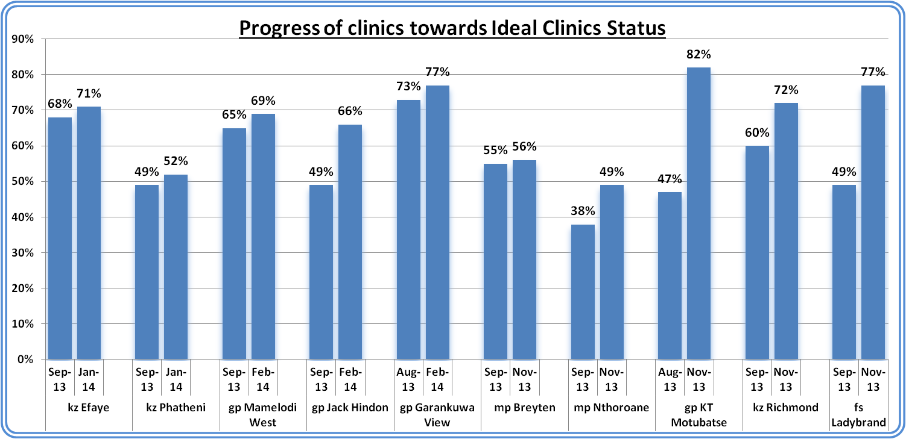
Responsibility

Slide 8
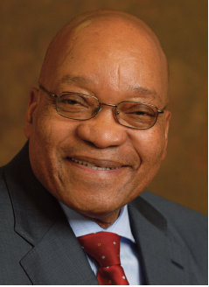
Operation Phakisa to fast-track NDP deliverables
President Jacob Zuma
“We will next month launch an adaptation of the Big Fast Results methodology that we have been discussing with the government of Malaysia... The methodology involves setting clear targets and following up with on-going monitoring of progress and making the results public. Using this implementation methodology, the Government of Malaysia was able to register impressive results within a short period. In South Africa, we have renamed the Malaysian approach Operation Phakisa, to emphasise its critical role in fast-tracking delivery on the priorities included in the National Development Plan 2030... We will also pilot this methodology to improve service delivery in our clinics nationwide, promoting Minister Motsoaledi’s Ideal Clinic Initiative”.
Operation Phakisa to fast-track NDP deliverables
20 June 2014

Slide 9
Adoption of Ideal Clinic concept
By 2014 – Operation Phakisa laboratory: Health.
Update of IC dashboard
10 components, 32 sub-components, 186 elements
Micro management tool to establish a platform for service delivery

Slide 10
Definition according to patient perspective
It is a clinic which:
Opens on time in the morning, according to its set operating hours, and which does not close until the last patient has been assisted, even if this is beyond the normal closing hours.
It is staffed by health care providers who treat people with dignity.
Provides community-based health promotion.
Is very clean, promotes hygiene and takes all precautionary measures to prevent the spread of diseases.
Has reasonable waiting times.

Slide 11
Definition according to patient perspective
Provides a comprehensive package of good quality health services every day.
Has as the basic necessities available, such as essential medicines.
Refers people to higher levels of care timeously when this is required.
Community members call it “our own clinic”, rather than a “government clinic” or a “state health facility”.

Slide 12
Aim and objective of Ideal Clinic programme
All clinics to be ideal within the next two years.
Establish district Perfect Permanent Team for Ideal Clinic Realization and Maintenance (PPTICRM) in every district
Conduct status determination using Ideal Clinic dashboard
Use results to informs service delivery improvements
Service delivery improvements facilitated by district PPTICRM and District Health Management Team in all provinces.
Ready for certification by OHSC.

Slide 13

www.health.gov.za
www.idealclinic.org.za
idealclinic@health.gov.za

