Slide 1
IDEAL CLINIC PROGRAMME
Training module III for Ideal Clinic Realisation and Maintenance
Software
Presenter:
Date:

Slide 2
Contents
Different modules of the software
Data flow
Off line module
Web-based module
  How to request user accounts
  Forms to request user accounts
  User permissions
  Logging on
  Functionality of the software

Slide 3
Modules of ICRM software
Live data
To be uploaded on live data
For training
On line module
www.health.gov.za or www.idealclinic.org.za
Off line module
Download from www.ideal clinic.org.za
On a memory stick that was provided to all facilities
Test module
test.idealclinic.co.za
No user account needed
Username = test
Password = password
Request user account from NDoH
No user account needed
Admin Pin = 1234

Slide 4
Data flow
Clinic/CHC
Computer available
Yes
Develop QIP
Connectivity available
No
Yes
No
Clinic/CHC capture data on online module .... Generate Report
QIP
Clinic/CHC capture data on off- line module Generate Report QIP
Clinic/CHC complete hard copy of dashboard
Clinic/CHC export data file to a memory stick/disk. Memory stick/disk send to or collected by Sub – /District Office
Report back to Clinic/CHC
Data capturer at Sub –/District Office capture data on online survey module
Generate report
Sub -/District Office import data file on online survey module
Data available on web based software (online module)

Slide 5

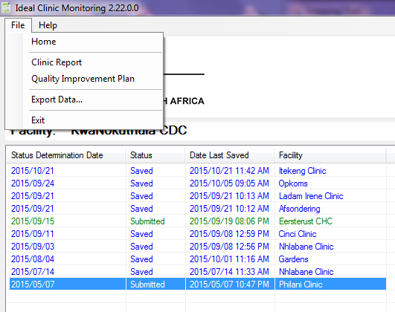
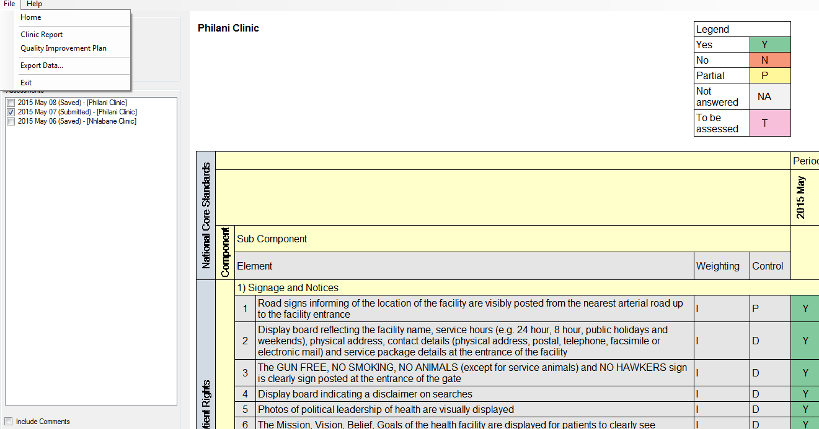
Off line module

Slide 6
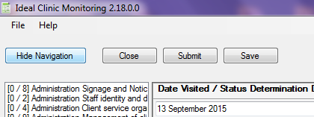
Off line module – verifying data
Data capturer capture SD
‘Save’ SD
Print SD report
Facility manager/PPTICRM verify that SD was captured correctly by signing and dating report
Give signed, dated SD report to data capturer to ‘Submit’ the data
*Status Determination (SD)

Slide 7
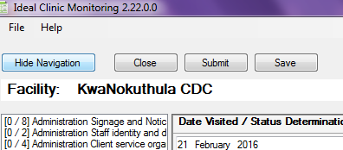
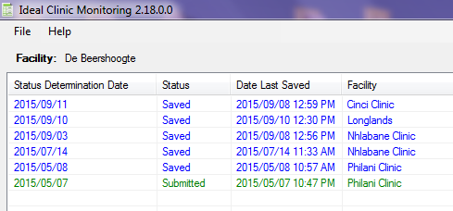
Off line module – status of SD
Before exporting data check that Status of the status
determination (SD) is reflected as “Submitted” and not
saved

Slide 8

Web-based software (1)
Access through NDoH website (www.health.gov.za)

Slide 9
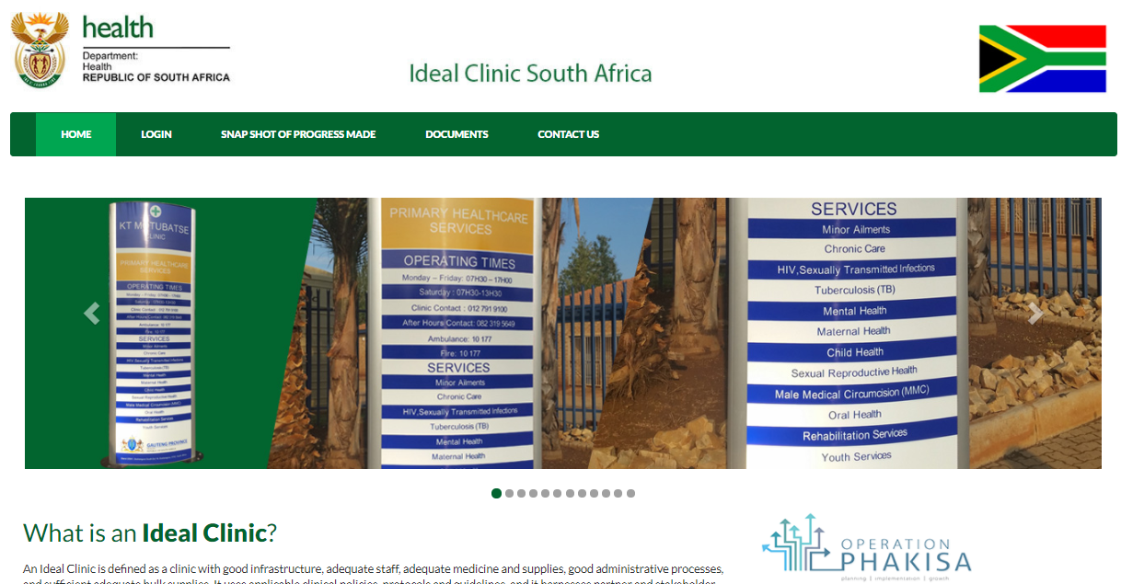
Web-based software (2)
www.idealclinic.org.za
Access on tab: ‘Login’

Slide 10
How to request user accounts
Complete form to request a user account – Must be electronic
Submit to District Ideal Clinic Coordinator/ Provincial Office
Submit to National Department of Health – idealclinic@health.gov.za

Slide 11
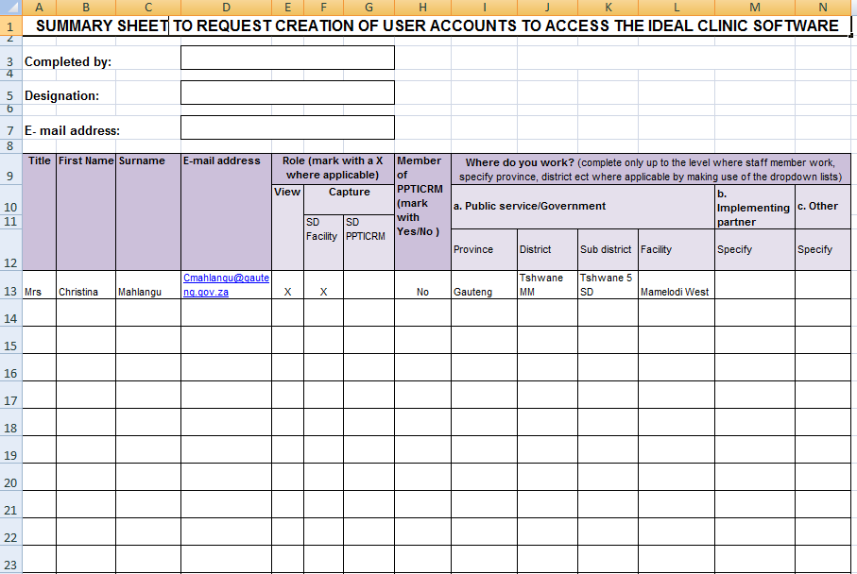
Forms to request user accounts

Slide 12
Permissions on user accounts - roles
Two roles
Viewing
Capturing
Capture for SD conducted by Facility manager = SD Facility manager
Capture for SD conducted by District PPTICRM = SD PPTICRM
Capture for SD conducted by District PPTICRM from neighboring district = SD PPTICRM PR
Capture for SD conducted by District PPTICRM from same district = SD PPTICRM PRU
* Status Determination (SD)

Slide 13
Permissions on user accounts to capture
National
Provincial
District
Sub district
Facility
Assigned according to where user work

Slide 14
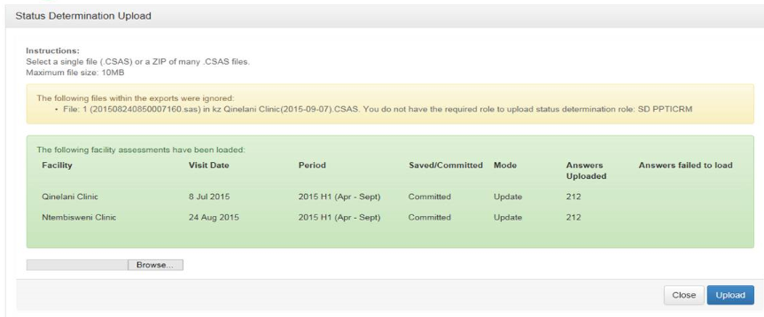
Permissions on user accounts to capture – Uploading of data from Off line module
Web based software check whether user that is uploading data
has permission to upload captured data: check the SD role as
well as facilities user have been registered to capture for

Slide 15
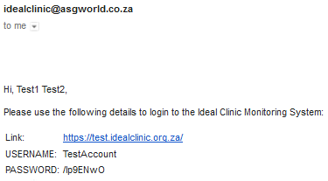
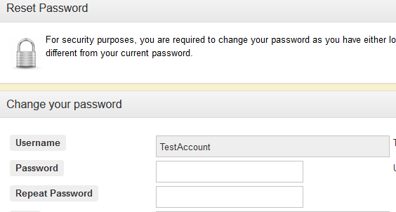
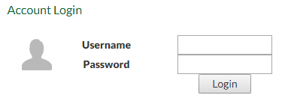
Login: Web-based information system
Once the form to request a user account has been processed you will receive an e-mail with login details
Enter your own password twice when logging on for the first time

Slide 16
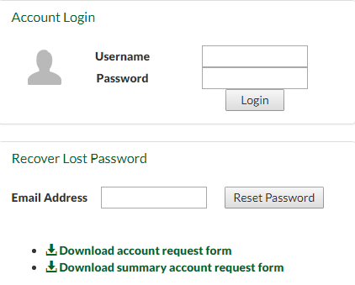

Web-based information system
What if I forgot my password?
Enter your e-mail address in the box provided, select ‘Reset Password’. An e-mail with a new temporary password will be sent.
Can also use it to verify if an account exist. If there is not an account for the e-mail address message will display

Slide 17
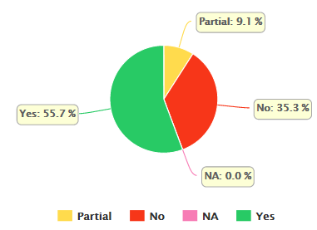
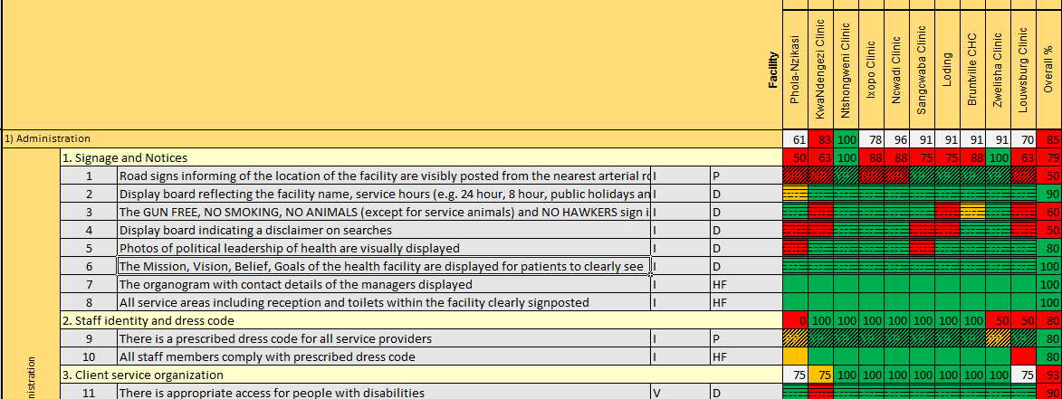
Functionality of software
Data management
    upload data from Offline module
    capture status determination
Dashboard
    graphic display of data
Reports
    Excel reports
Help
    video clips and document section

Slide 18
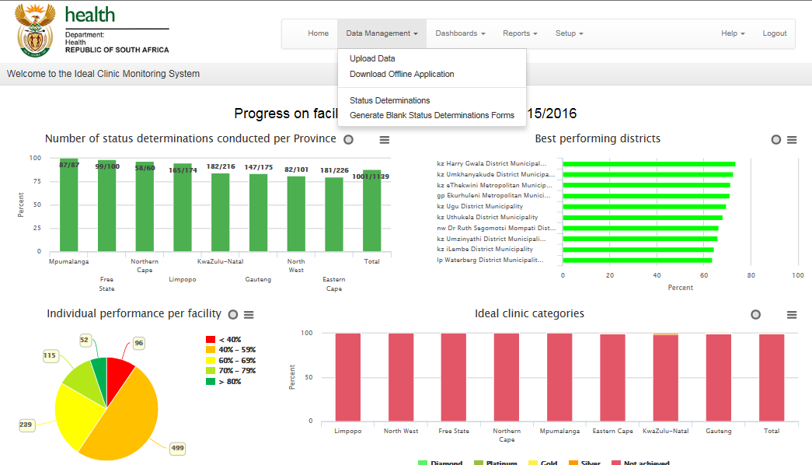
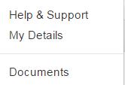
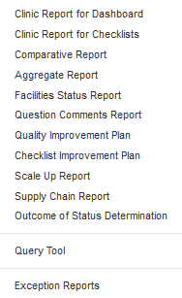
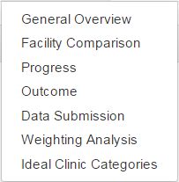
Functionality of software (2)

Slide 19
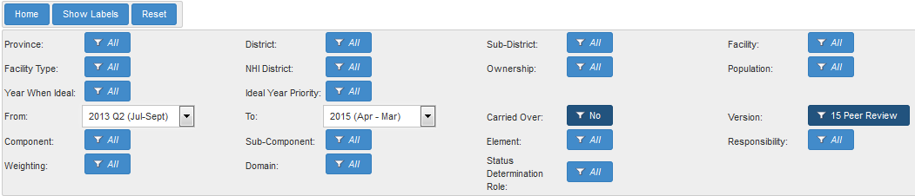
Functionality of software (3)
Filters - generation of reports at various levels
Filters
Province | Facility type | Component | Period
District | NHI district | Sub Component | Responsibility
Sub district | Ownership | Element | Weighting
Facility | Population | Domain | Status determination role
Version | Carried over | Year when Ideal
 |  | Ideal Year priority

Slide 20

END
www.health.gov.za
www.idealclinic.org.za
idealclinic@health.gov.za

